Slide 1
Programmable control systems
The first ones was introduced in the late 1960’s
Before that we had relay logic circuits which were hard wired

Slide 2
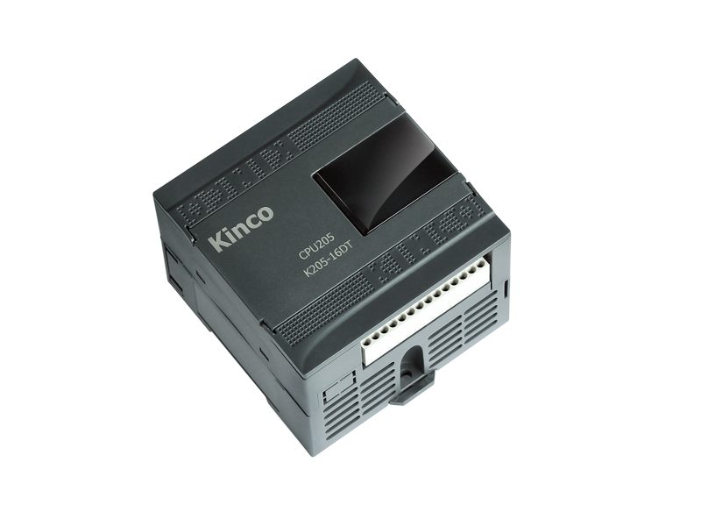
Programmable control systems
As technology quickly progressed, many complex operational tasks have been solved by connecting programmable logic controllers (PLC) and a central computer. Beside connections with devices, possibilities for communication among instruments are so great that they allow a high level of exploitation and process coordination.
With the execution of a program stored in program memory, PLC continuously monitors status of the system through signals from input devices. Based on the logic implemented in the program, PLC determines which actions need to be executed with output instruments. To run more complex processes it is possible to connect more PLC controllers to a central computer

Slide 3
Advantages of control panel that is based on a PLC controller:
1. number of wires needed for connections is reduced by 80%
2. Consumption is greatly reduced
3. allow for fast and easy error detection.
4. Change in operating sequence or application of a PLC controller to a different operating process can easily be accomplished
5. Needs fewer spare parts
6. It is much cheaper compared to a conventional system
7. Reliability of a PLC is greater than that of an electro-mechanical relay or a timer

Slide 4
Where is PLC used and why?
First used by automotive
Hard wired relays were complicated, expensive, unreliable
Lots of I/O
Many components are controlled
Stability/ Reliability
Designed for the industry
Compared to PC, this can not crash
Home automation
Very easy to program
Visual programming

Slide 5
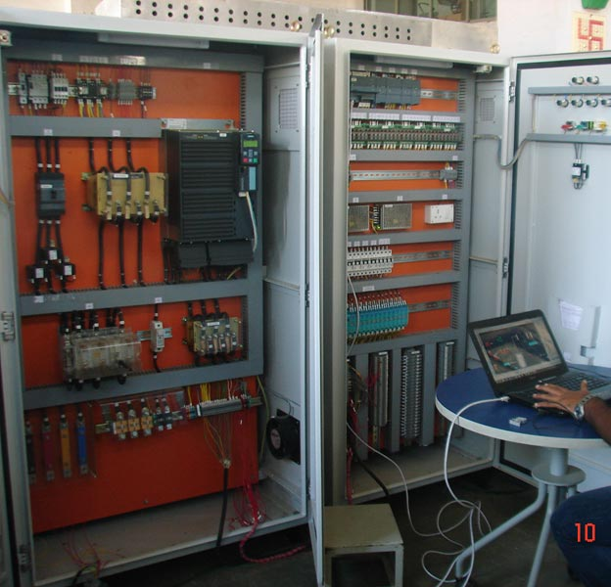
Types of PLCs
Small system – less than 500 I/Os.
Medium system has I/Os ranging from 500 to 5,000.
Large system with over 5,000 I/Os

Slide 6
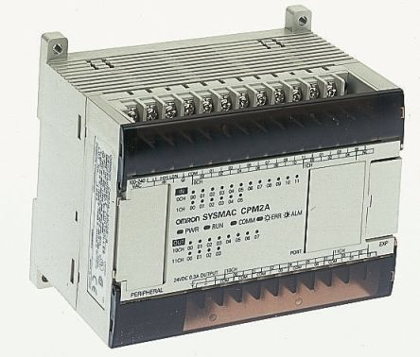
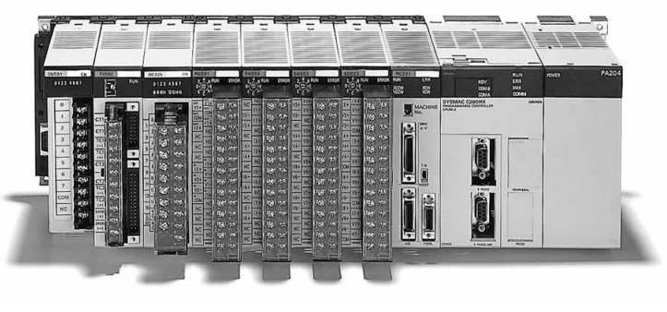
Types of PLCs

Slide 7
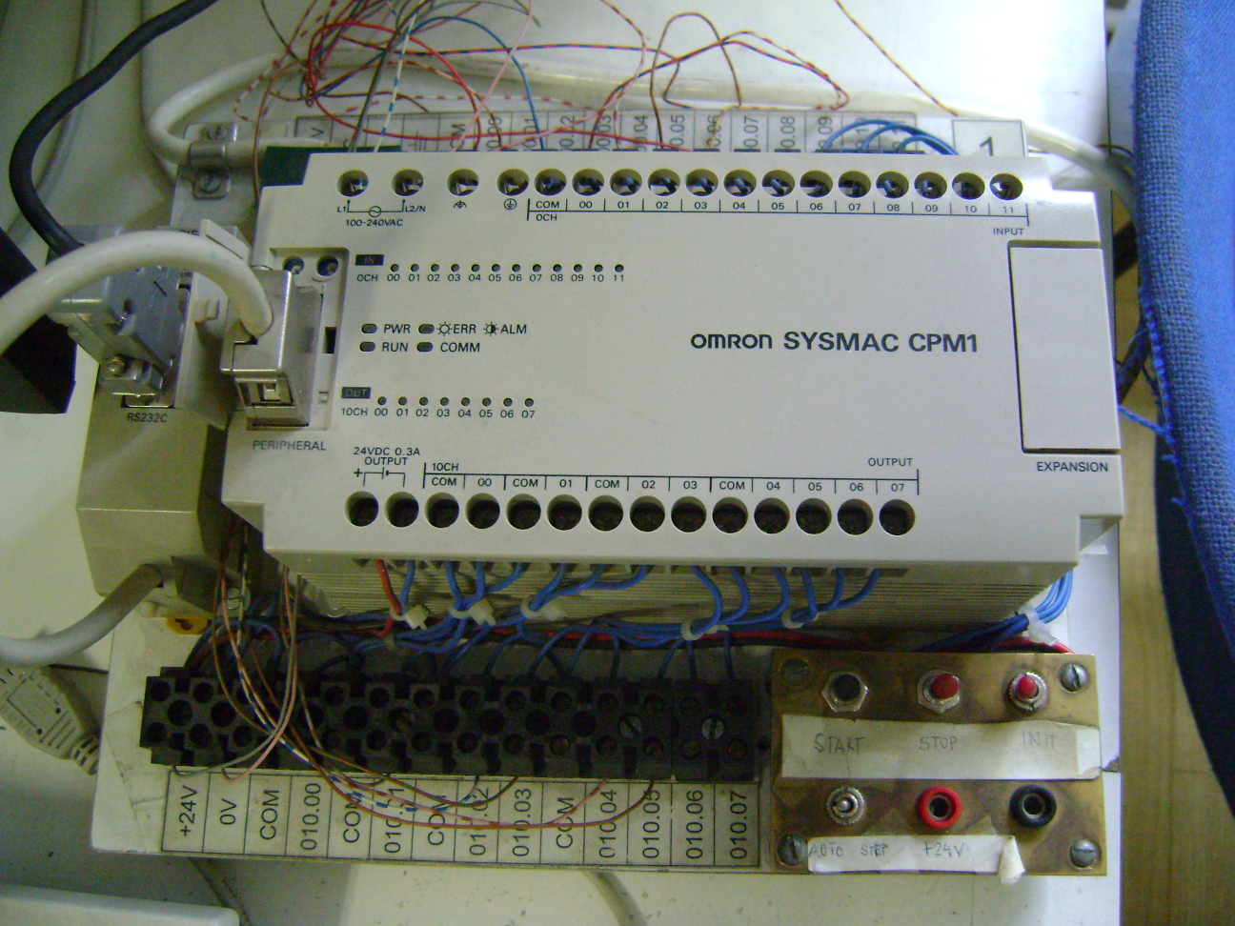
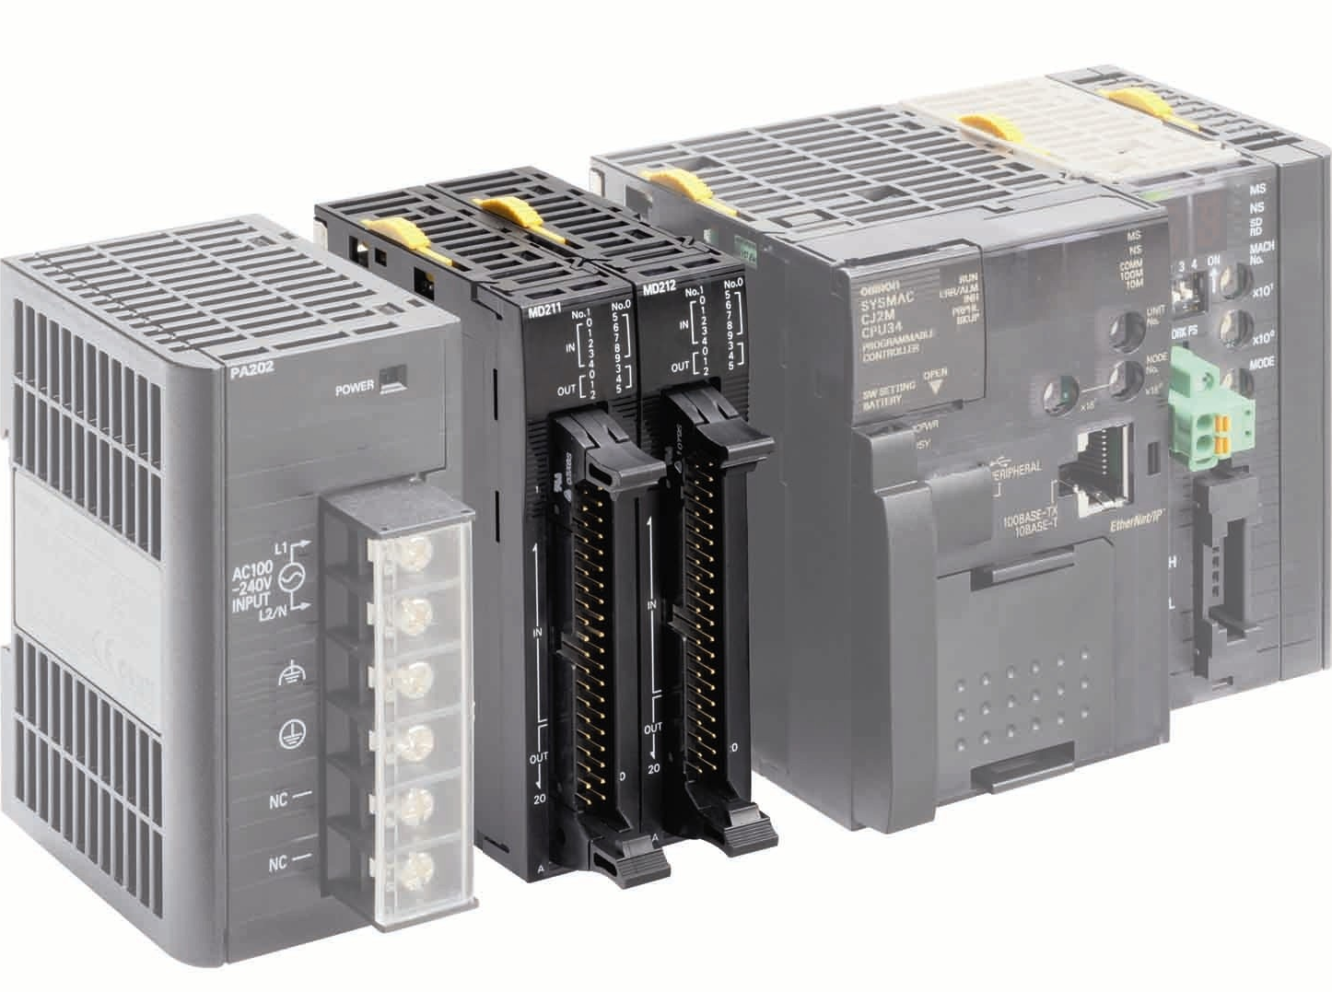
Port selection, modules
Input
Output
Start
Stop
Init

Slide 8
PLC programming languages
Ladder diagram (LD)
Sequential Function Charts (SFC)
Function Block Diagram (FBD)
Structured Text (ST)
Instruction List (IL)

Slide 9
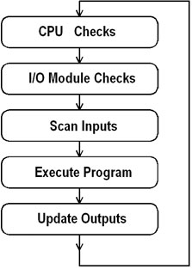
Process of a scan cycle
Input Scan:
A simple way of looking at this is the PLC takes a snapshot of the inputs and solves the logic
Execute Program (or Logic Execution):
The PLC executes a program one instruction at a time using only the memory copy of the inputs the ladder logic program
Output Scan:
When the ladder scan completes, the outputs are updated using the temporary values in memory

Slide 10
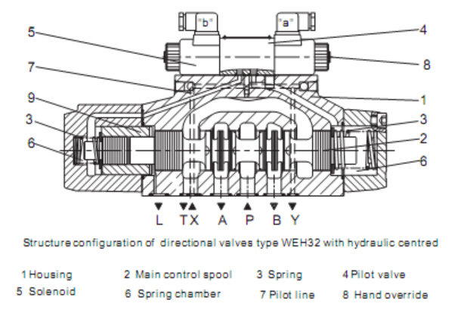
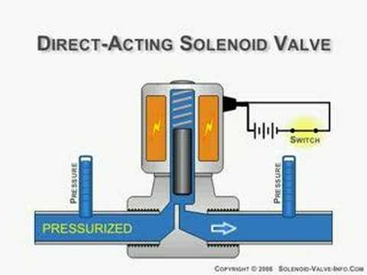
Solenoid valves
A solenoid valve is an electromechanically operated valve.

Slide 11
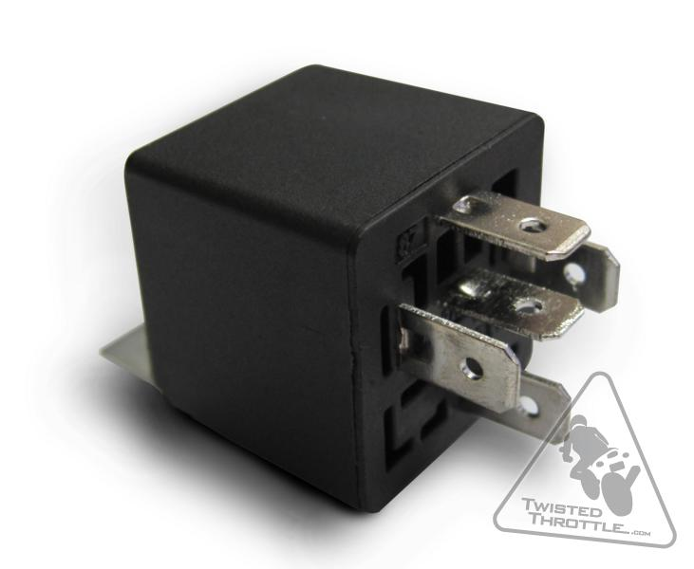
Relay

Slide 12
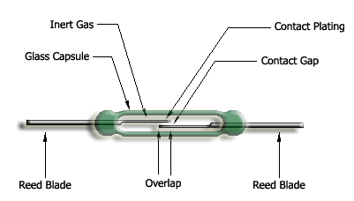
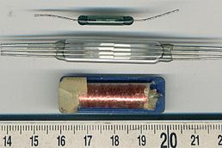
Reed Relay
It is a type of relay that uses an electromagnet to control one or more reed switches.
The contacts are of magnetic material and the electromagnet acts directly on them without requiring an armature to move them

Slide 13
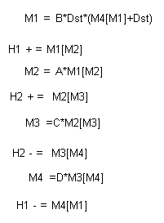
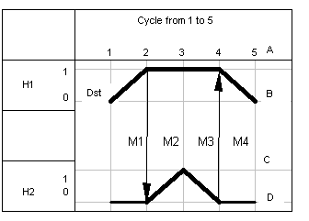
Shift Register

Slide 14
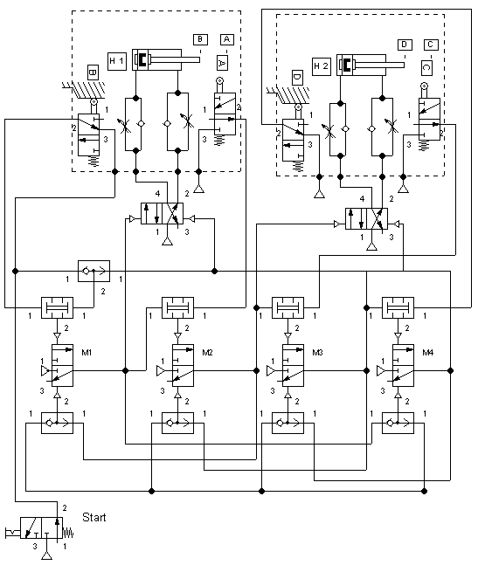
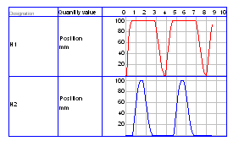

Slide 15
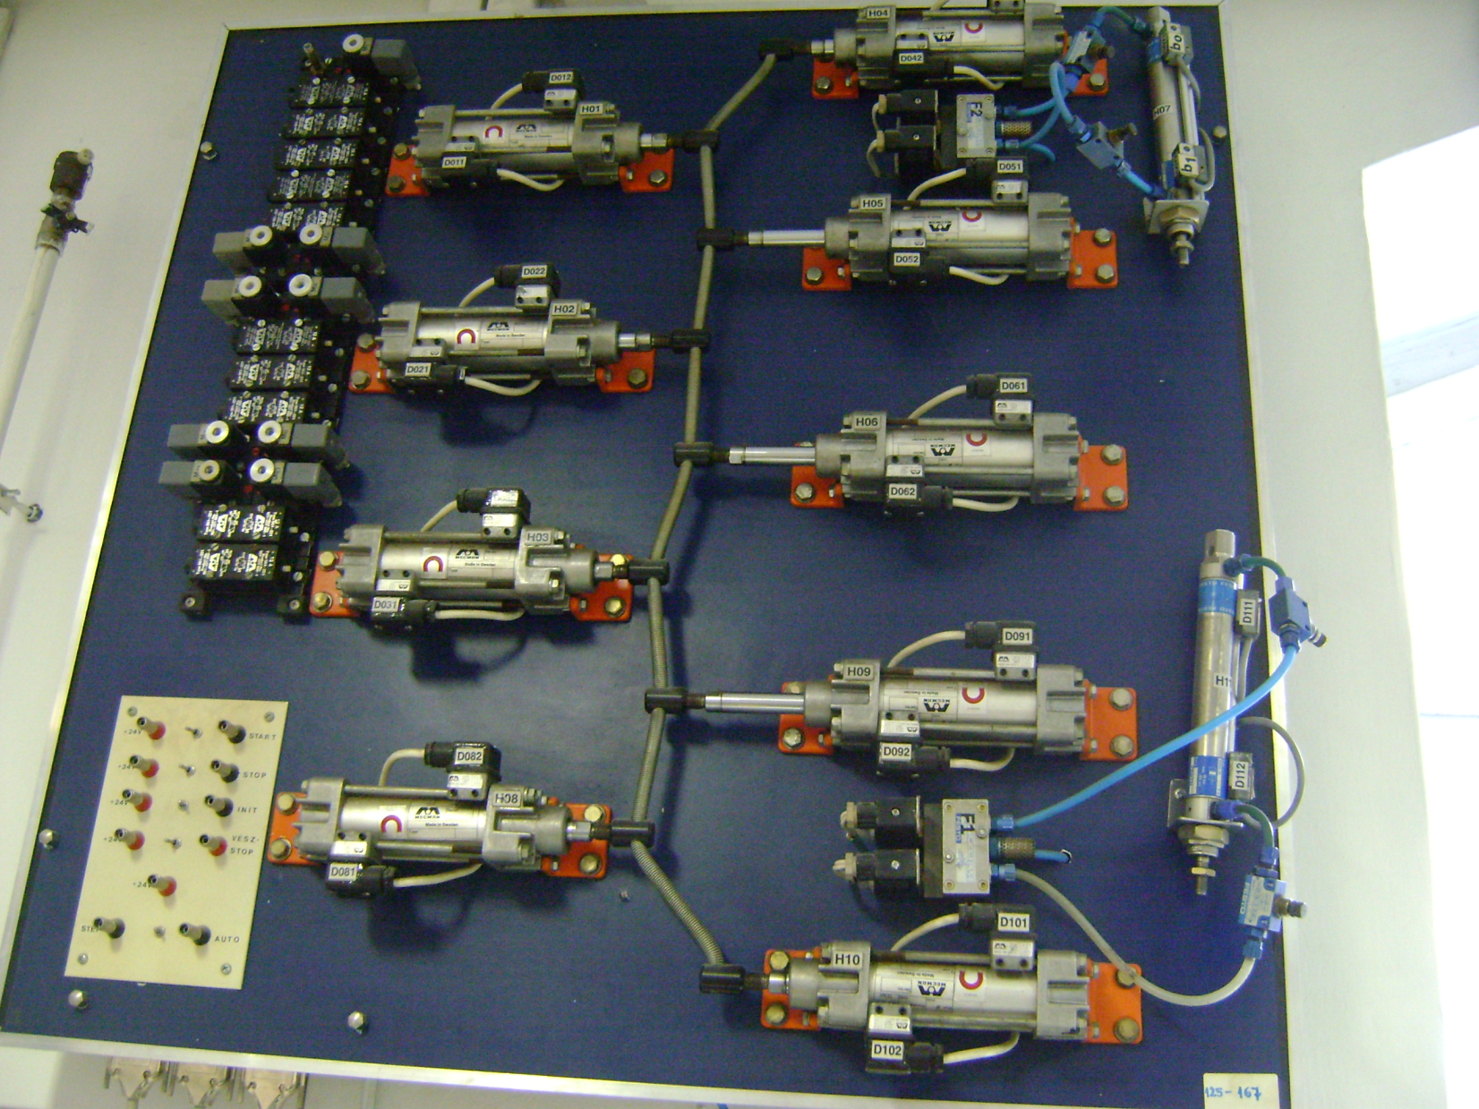
In Lab
H4
H1
H5
2
H2
H7
H6
3
H3
H9
H11
H8
H10
1
H10 single acting (monostable); H11 double acting cylinder (bistable)

Slide 16
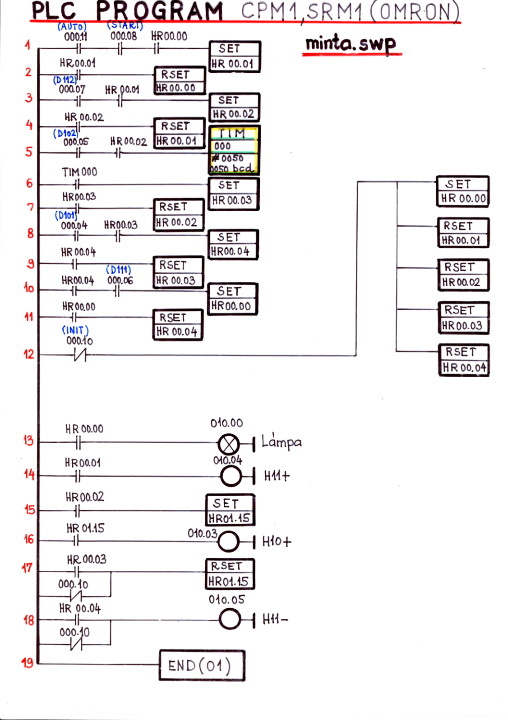
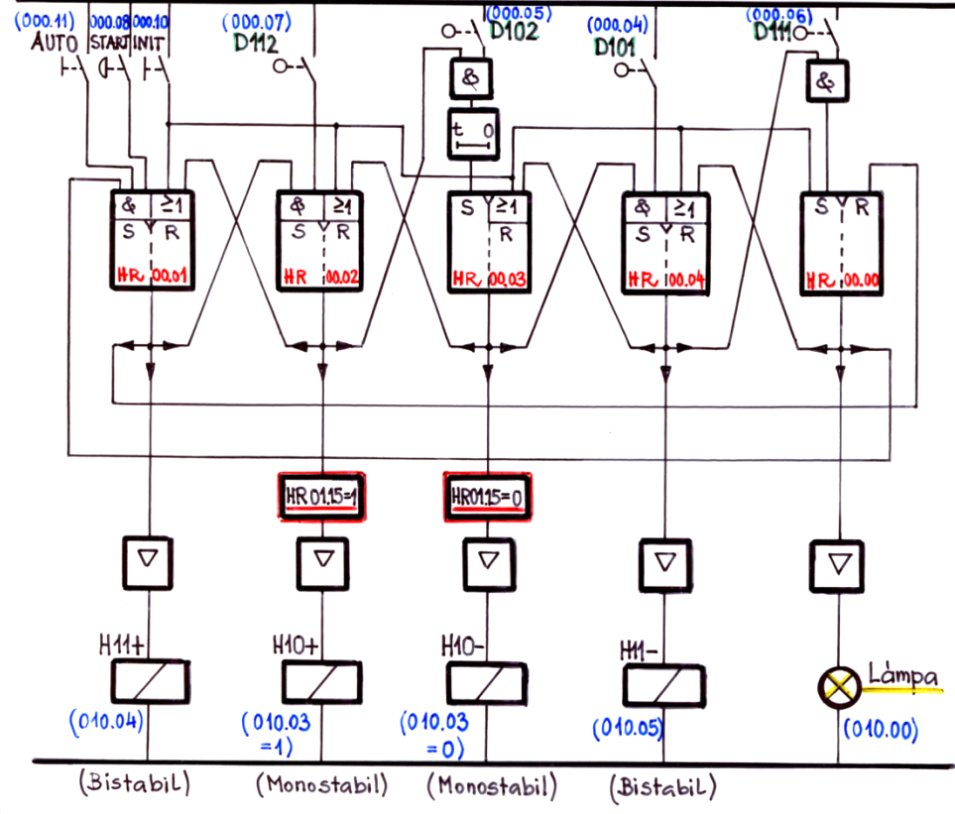
H11
Physical Model PLC
D112 (000.07)
D111
D112
D101
D111 (000.06)
START
D102 ΔT
D102 (000.05)
H10
D101 (000.04)
1
2
3
4
1 Working cyclic
16

