Slide 1
Vehicle Informatics
(Vehicle System Informatics)
Lecture
Part 05
(MOST)
Dr. Tamás Szakács: szakacs.tamas@bgk.uni-obuda.hu,
Ákos Jányoki: janyoki.akos@bgk.uni-obuda.hu

Slide 2
MOST (Media Oriented Systems Transport)
A high-speed (Up to 150Mb/s) multimedia network technology optimized by the automotive industry. Can be used for applications inside or outside the car.
JInfo_EA_kommunikacio-BME.pdf

Slide 3
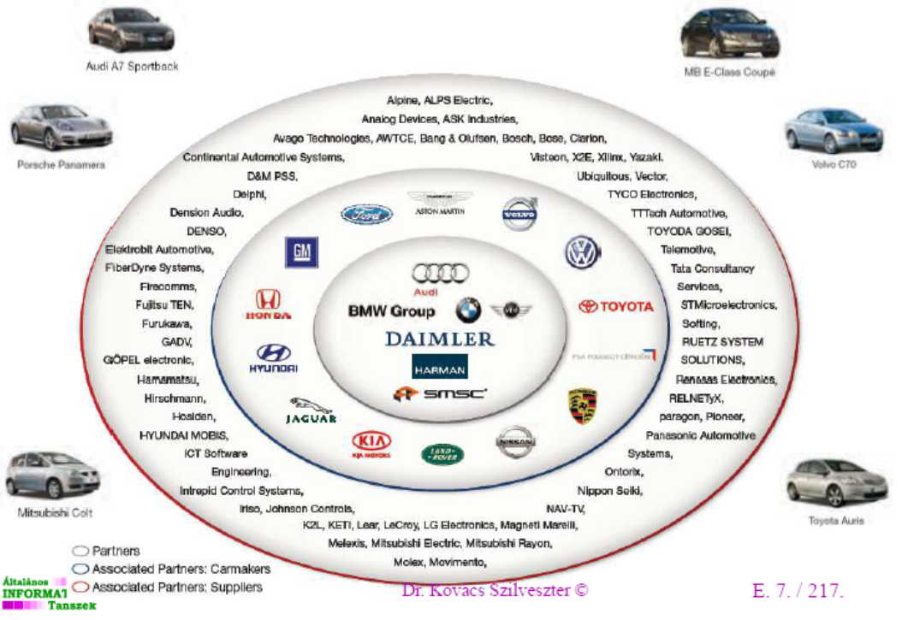
MOST (Media Oriented Systems Transport)
MOST technology is used in almost every car brand worldwide, including Audi, BMW, General Motors, Hyundai, Jaguar, Lancia, Land Rover, Mercedes-Benz, Porsche, Toyota, Volkswagen, SAAB, SKODA, SEAT and Volvo. SMSC and MOST are registered trademarks of Standard Microsystems Corporation (“SMSC”), now owned by Microchip Technology.
JInfo_EA_kommunikacio-BME.pdf

Slide 4
MOST
MOST is a synchronous network.
  A timing master supplies the clock with a synchronous and continuous data signal
  All other devices synchronize their operation to this base signal.
This technology eliminates the need for buffering and sample rate conversion
  Very simple and inexpensive devices can be connected
  The hardware of the network interface itself is lean and cost effective.
The technology is similar to what the public switched telephone network uses.
mostcooperation.com

Slide 5
MOST
Within the synchronous base data signal,
  multiple streaming data channels
  one control channel are transported.
The control channel is used to set up what streaming data channels the sender and receiver are to use. Once the connection is established, data can flow continuously and no further addressing or processing of packet label information is required.
The bandwidth of the streaming data channels is always available and reserved for the dedicated stream so there are no interruptions, collisions, or slow-downs in the transport of the data stream. This is the optimum mechanism for delivering streaming data (information that flows continuously) like audio and video. MOST has been designed for high quality of service and cost effective transport of audio and video.
mostcooperation.com

Slide 6
MOST
Sending asynchronous, packet based data in addition to the control channel and the streaming data
  Runs on top of the permanent synchronous data signal
  Completely separate from the control channel and the streaming data channels so that none of them interfere with each other
  for computer based data, such as Internet traffic or information from a navigation system, is typically sent in short (asynchronous) bursts as packets and is often going to many different places
mostcooperation.com

Slide 7
MOST Frame
The structure of the MOST frame

Slide 8
MOST Frame
The structure of the MOST frame
The first part is the preamble, which is 4 bits long and means the start of the frame. Each frame in a block has his own preamble. Its task is to synchronize the clock between the Slaves and the Master.
Second part is the boundary descriptor / delimiter which is 4 bits long as well, and separates the preamble from the data field.Specifies how are the available bytes of the data field divided for synchronous and asynchronous part.

Slide 9
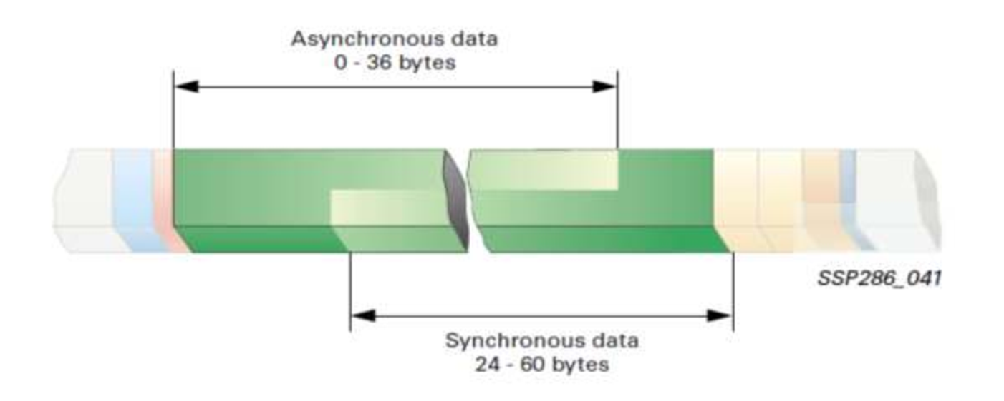
MOST Frame Data Field
The structure of the MOST frame
The value of the the boundary descriptor is between 6 and 15 (decimal), and the expected sync data is obtained by being multiplied by 4. The result will show the number of the synchronous bytes from the total possible 60 bytes.
JInfo_EA_kommunikacio-BME.pdf

Slide 10
MOST Frame Data Field
Asynchronous data (eg navigation data, images, messages, vectors, etc.) are transmitted when a control unit receives a frame whose recipient is the same as the one you want to send asynchronous data, and there is still room left in the frame
(Quadlet) in the data field. That is, asynchronous data is irregular
at intervals and also will be transmitted in "Quadlets" (4 bytes)
JInfo_EA_kommunikacio-BME.pdf

Slide 11
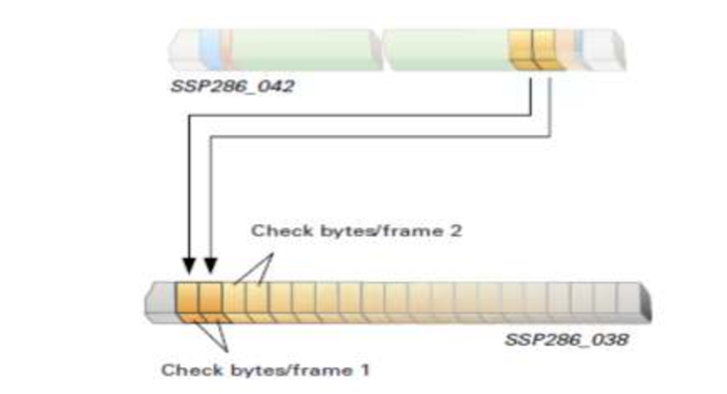
MOST Check Byte and Check Frame
Check byte (control bytes):
  contain the sender's and recipient's ID and the commands, control signals for the destination controller, such as input switching, or
  any request to change any setting (eg volume change, EQ, etc.)
Check frame:
  16 Check byte pairs (16 frames, 32 bytes)
JInfo_EA_kommunikacio-BME.pdf

Slide 12
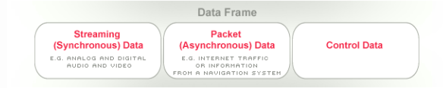
MOST Summarized
MOST is a multiplex network that has different channels with their own mechanisms to transport all the various signals and data streams that occur in multimedia and infotainment systems.
They all run on top of a synchronous base data stream which guarantees high quality of service for the audio and video signals where disturbances are not acceptable.
mostcooperation.com

Slide 13
Key Features MOST
Ease of use
  Simple connectors
  No hum loops, no radiation
  Plug-n-Play; self identifying devices with auto initialization
  Dynamically attachable and re-configurable devices
  Virtual network management including channel allocation, system monitoring addressing and power
  management
mostcooperation.com

Slide 14
Key Features MOST
Wide application range
  applications with varied bandwidth requirements
  high degree of data integrity with low jitter
  support of asynchronous and synchronous data transfer
  support of multiple masters
  supports up to 64 devices
  simultaneous transmission of multiple data streams such as control, packet and real-time information
  devices can be constructed out of multiple functions
  low overhead due to embedded network management
mostcooperation.com

Slide 15
Key Features MOST
Synchronous bandwidth
  synchronous channels provide guaranteed bandwidth with no buffering required
Asynchronous bandwidth
  variable asynchronous bandwidth with additional dedicated real-time control channels
mostcooperation.com

Slide 16
Key Features MOST
Flexibility
  wide range of real-time channel sizes and packet sizes
  remote operation and flow control
  variable asynchronous bandwidth with additional dedicated real-time control channels
  protocol independent
mostcooperation.com

Slide 17
Key Features MOST
Synergy with Consumer and PC Industries
  operates with or without PC
  consistent with PC streaming
Low Implementation Cost
  low cost channel to distribute control information without extra wiring
  zero data overhead to move synchronous data after a connection is established
  synchronous channels eliminate the need for buffering and sample rate conversion
  suitable for embedding in consumer devices and peripherals
  cost-effective electrical and optical solutions
  inexpensive silicon from many suppliers
mostcooperation.com

Slide 18
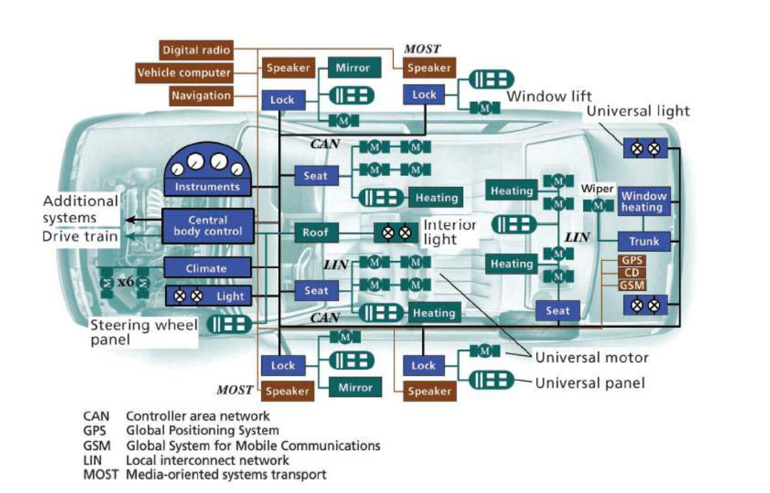
Bus Systems Overview

Slide 19
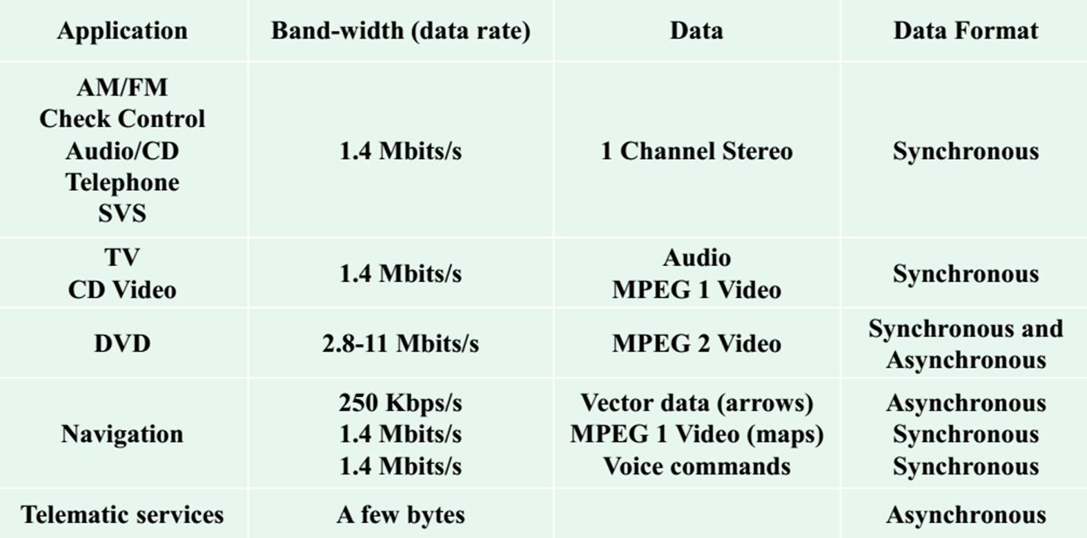
MOST Application Overview

Slide 20
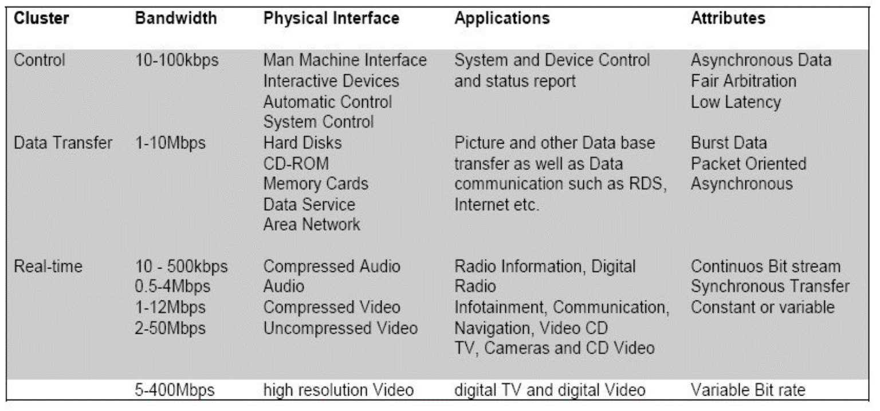
MOST Bandwidth Overview

Slide 21
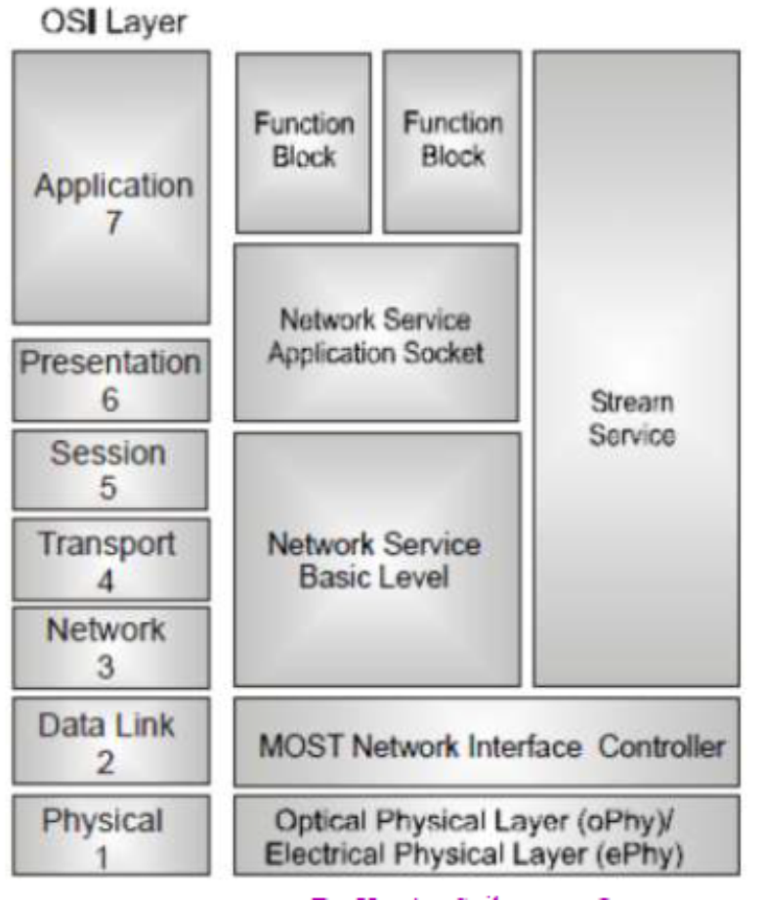
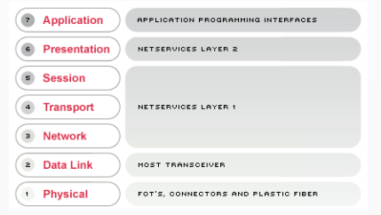
OSI / ISO MOST
mostcooperation.com

Slide 22
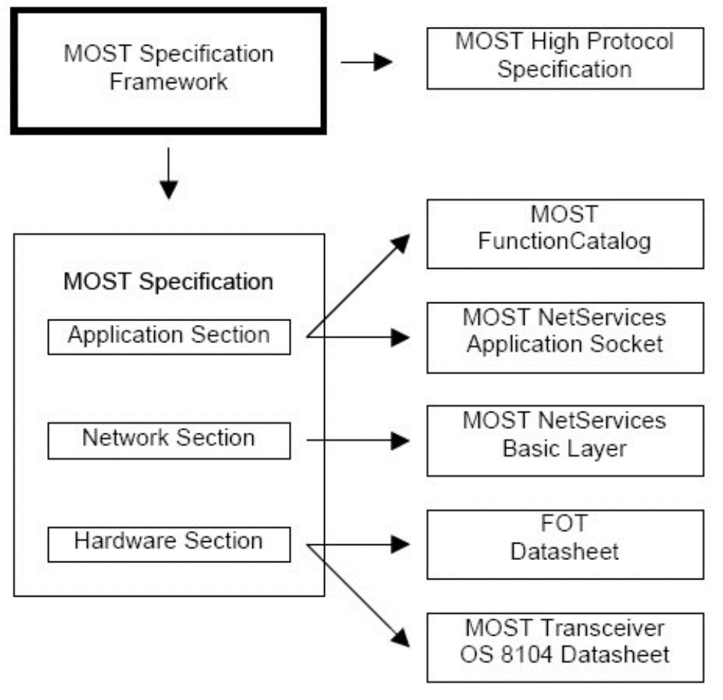
MOST Topologies
mostcooperation.com

Slide 23
MOST Topologies
Point to point
Ring
Ring incorporating splitters
Star of rings
mostcooperation.com

Slide 24
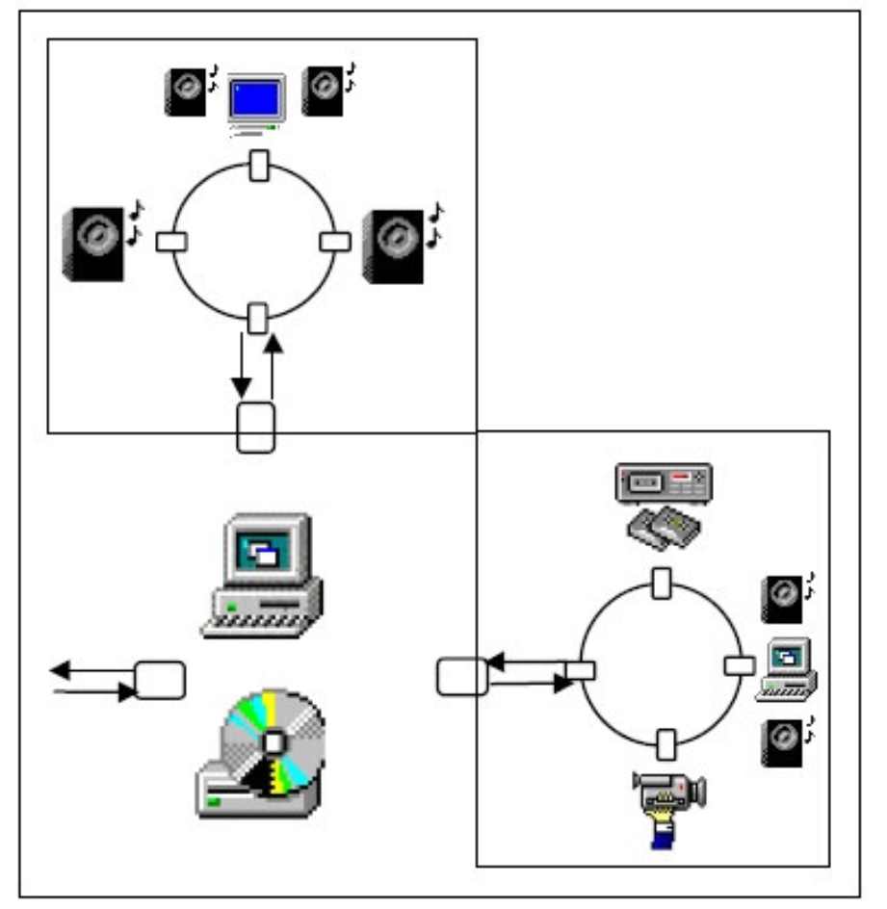
MOST Topologies
Star of rings
mostcooperation.com

Slide 25
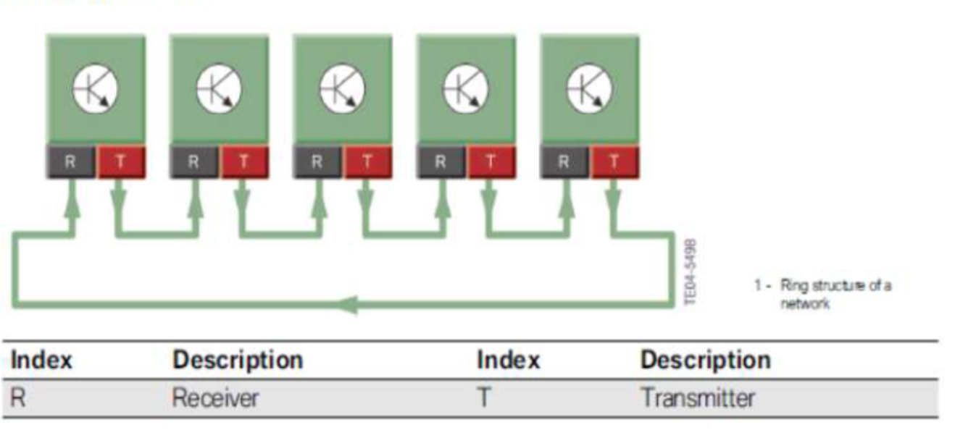
MOST Topologies
Ring structure
mostcooperation.com

Slide 26
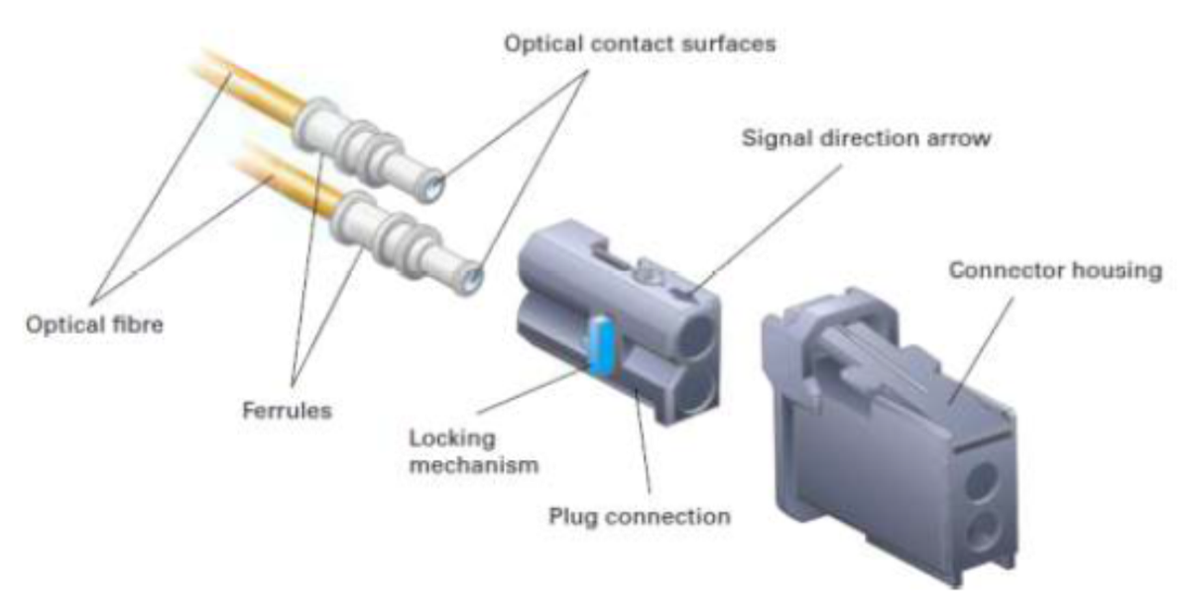
MOST Cabling
Connectors
mostcooperation.com

Slide 27
MOST Cabling
Construction of fiber optic cable
mostcooperation.com

