Slide 1
Vehicle Informatics
(Vehicle System Informatics)
Introduction
and
Presentation 01
Dr. Tamás Szakács: szakacs.tamas@bgk.uni-obuda.hu,
Ákos Jányoki: janyoki.akos@bgk.uni-obuda.hu

Slide 2
BUS systems
JInfo_EA_kommunikacio-BME.pdf
ÓE-BGK MEI Vehicle Informatics Dr. Tamás Szakács

Slide 3
BUS system
A vehicle bus is a specialized internal communications network that interconnects components inside a vehicle (e.g. automobile, bus, train, industrial or agricultural vehicle, ship, or aircraft).
Special requirements for vehicle control such as assurance of message delivery, of non-conflicting messages, of minimum time of delivery, of low cost, and of EMF noise resilience, as well as redundant routing and other characteristics mandate the use of less common networking protocols.
Protocols include Controller Area Network (CAN), Local Interconnect Network (LIN) and others.
Conventional computer networking technologies (such as Ethernet and TCP/IP) are rarely used, except in aircraft, where implementations of the ARINC 664 such as the Avionics Full-Duplex Switched Ethernet are used. Aircraft that use AFDX include the B787, the A400M and the A380.
https://en.wikipedia.org/wiki/Vehicle_bus
ÓE-BGK MEI Vehicle Informatics Dr. Tamás Szakács

Slide 4
BUS system’s background
The main driving forces for the development of vehicle network technology have been the advances made in the electronics industry in general and government regulations imposed, in order to make the automobiles environmentally friendly.
With stringent emission standards for automobiles, it became impossible to attain the required degree of control without the help of on-board computing devices. On-board electronic devices have also contributed substantially to vehicle performance, occupant comfort, ease of manufacture and cost effectiveness.
At one time, a car radio was likely the only electronic device in an automobile, but now almost every component of the vehicle has some electronic feature.
Typical electronic modules on today's vehicles include the:
Engine Control Unit (ECU)
Transmission Control Unit (TCU)
Anti-lock Braking System (ABS)
Body Control Modules (BCM).
https://en.wikipedia.org/wiki/Vehicle_bus
ÓE-BGK MEI Vehicle Informatics Dr. Tamás Szakács

Slide 5
BUS system’s background
An electronic control module typically gets its input from sensors (speed, temperature, pressure, etc.) that it uses in its computation.
Various actuators are used to enforce the actions determined by the module (turn the cooling fan on, change gear, etc.). The modules need to exchange data among themselves during the normal operation of the vehicle. For example, the engine needs to tell the transmission what the engine speed is, and the transmission needs to tell other modules when a gear shift occurs. This need to exchange data quickly and reliably led to the development of the vehicle network, as the medium of data exchange.
The automotive industry quickly realized the complexity of wiring each module to every other module. Such a wiring design would not only be complex, it would have to be altered depending on which modules were included in the specific vehicle. For example, a car without the anti-lock brake module would have to be wired differently than one that included anti-lock brakes.
https://en.wikipedia.org/wiki/Vehicle_bus
ÓE-BGK MEI Vehicle Informatics Dr. Tamás Szakács

Slide 6
BUS system’s background
The industry's answer to this problem was to create a central network in the vehicle. Modules could be 'plugged' into the network and would be able to communicate with any other module that was installed on the network. This design was easier to manufacture, easier to maintain and provided the flexibility to add and remove options without affecting the entire vehicle's wiring architecture. Each module, a node on the vehicle network, controls specific components related to its function and communicates with the other modules as necessary, using a standard protocol, over the vehicle network.
Networks were not new, but their application to the vehicle was. The networks for the vehicles called for:
Low cost
Immunity from external noise
Ability to operate in harsh environments
Overall robustness and reliability
https://en.wikipedia.org/wiki/Vehicle_bus
ÓE-BGK MEI Vehicle Informatics Dr. Tamás Szakács

Slide 7
BUS system’s classification
The applications for network protocols in vehicles can be separated in four distinct areas.
There is no single protocol, which could claim to represent a “one fits all” solution for all these areas. Each of them requires specific protocol features:
Multimedia applications, calling for protocols providing high speed, high bandwidth, and even wireless interconnection, like MOST, D2B, or Bluetooth;
Emerging safety critical applications in chassis and power train (x-by wire) calling for a fault tolerant, dependable protocol, like TTP/C, Byteflight, TT-CAN or others;
Conventional body and powertrain applications, mainly using CAN;
Mechatronic type applications such as smart sensors and actuator, or even complex ECUs with simple communications needs, being addressed by low-end protocols like LIN, TTP/A, J-1850, and quite a few other OEM or Tier-I in-house protocols.
w_specks_lin_baden-baden_paper[1].pdf
ÓE-BGK MEI Vehicle Informatics Dr. Tamás Szakács

Slide 8
BUS system’s classification
JInfo_EA_kommunikacio-BME.pdf
ÓE-BGK MEI Vehicle Informatics Dr. Tamás Szakács

Slide 9
Real-Time Control Systems
Time-triggered control system
  All activities are carried out at certain points in time know a priori
  All nodes have a common notion of time, based on approximately synchronization
Event-triggered control system
  All activities are carried out in response to relevant events external to the system
ÓE-BGK MEI Vehicle Informatics Dr. Tamás Szakács

Slide 10
BUS system’s classification
JInfo_EA_kommunikacio-BME.pdf
ÓE-BGK MEI Vehicle Informatics Dr. Tamás Szakács

Slide 11
BUS system’s classification
w_specks_lin_baden-baden_paper[1].pdf
ÓE-BGK MEI Vehicle Informatics Dr. Tamás Szakács

Slide 12
BUS system’s classification
BUS systems
Inner
Control Bus
Data Bus
Outer (industrial)
Field Bus
Address Bus
CAN Bus
PROFI Bus
Inter Bus
ASI Bus
Industrial Ethernet…..
Mod Bus
……
ÓE-BGK MEI Vehicle Informatics Dr. Tamás Szakács

Slide 13
BUS system’s classification
JInfo_EA_kommunikacio-BME.pdf
ÓE-BGK MEI Vehicle Informatics Dr. Tamás Szakács

Slide 14
BUS system’s classification
JInfo_EA_kommunikacio-BME.pdf
ÓE-BGK MEI Vehicle Informatics Dr. Tamás Szakács

Slide 15
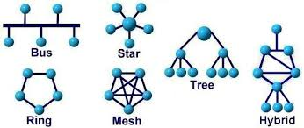
Main Network Topologies
Star
Central control
Relatively simple, but in case of Central fail, the network is failed, too
Bus
Bus-access control
Hierarchical (segmented) bus-systems
Tree
Directional data flow (data to head of tree)
Building’s networks - EIB
Ring
TOKEN passing method
Example: INTERBUS
  several combinations
ÓE-BGK MEI Vehicle Informatics Dr. Tamás Szakács

Slide 16
Communication transfer medium
Radio vawe:
    WiFi, BlueTooth, GSM, GPRS
Physical Cable system:
    Paired wire (ASI Bus)
    Coax cable (Industrial Ethernet)
    Optic cable (Ethernet)
ÓE-BGK MEI Vehicle Informatics Dr. Tamás Szakács

Slide 17
Data Transfer Control Methods
Access control is a way of limiting access to a system (BUSes) or to physical or virtual resources. In computing, access control is a process by which users (PROCESSORs) are granted access and certain privileges to systems (BUSes), resources or information.
In access control systems, users must present credentials (TOKEN) before they can be granted access. In physical systems, these credentials may come in many forms, see later.
Since a serial communication system such as CAN is based on a two-wire connection between nodes in the network, i.e. all nodes are sharing the same physical communication bus, a method of message/data collision avoidance is mandatory to assure a safe data transfer and to avoid delays resulting from the necessary restoration of proper bus conditions after the collision.
ÓE-BGK MEI Vehicle Informatics Dr. Tamás Szakács

Slide 18
Bus Access Methods
A collision may occur when two or more nodes in the network are attempting to access the bus at virtually the same time, which may result in unwelcome effects, such as bus access delays or even destruction/damage of messages.
There are various methods of collision avoidance between the various fieldbus systems and in most cases the collision avoidance is actually a collision “repair”, which requires an unspecified bus recovery time, therefore taking up valuable bandwidth, and usually results in the destruction of the message.
Random access: - The „workstation (WS)” is randomly checking the BUS state, and if the BUS is not busy can initiate the transmit. (CSMA/CD)
Distributed access: Just one „workstation” has the ability to transmit. This ability is passed (after the determined time-period) from WS to WS (CSMA/CA)
Centralized access: a central „station” controlling the BUS accesses. The other WSs listening for permit to transfer. (TDMA, Master-Slave)
ÓE-BGK MEI Vehicle Informatics Dr. Tamás Szakács

Slide 19
BUS system’s classification
JInfo_EA_kommunikacio-BME.pdf
ÓE-BGK MEI Vehicle Informatics Dr. Tamás Szakács

Slide 20
BUS system’s classification
JInfo_EA_kommunikacio-BME.pdf
ÓE-BGK MEI Vehicle Informatics Dr. Tamás Szakács

Slide 21
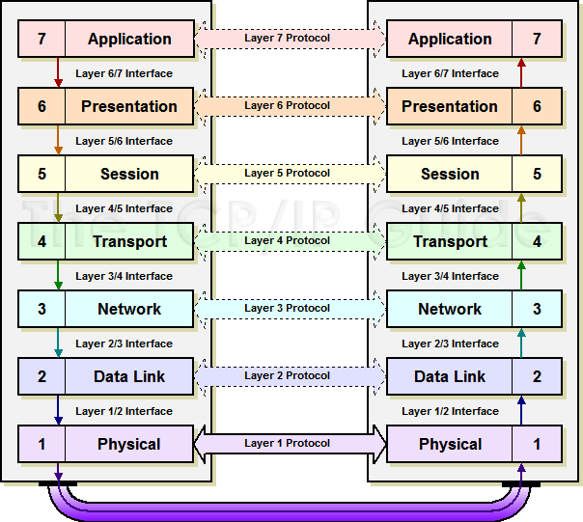
ISO/OSI 7 layers model
The Open Systems Interconnection model (OSI model) is a conceptual model that characterizes and standardizes the communication functions of a telecommunication or computing system without regard to their underlying internal structure and technology. Its goal is the interoperability of diverse communication systems with standard protocols. The model partitions a communication system into abstraction layers. The original version of the model defined seven layers.
ÓE-BGK MEI Vehicle Informatics Dr. Tamás Szakács

