Slide 1
Vehicle Informatics
(Vehicle System Informatics)
Flexray
Dr. Tamás Szakács: szakacs.tamas@bgk.uni-obuda.hu,
Ákos Jányoki: janyoki.akos@bgk.uni-obuda.hu

Slide 2

FlexRay
Advanced Automotive Communication System
Outline:
Scalable static and dynamic message transmission (deterministic and flexible)
High net data rate of 5 Mbit/sec; gross data rate approximately 10Mbit/sec
Scalable fault-tolerance (single and dual channel)
Error containment on the physical layer through an independent Bus Guardian
Fault tolerant clock synchronisation (global time base)

Slide 3
FlexRay
Motivation
Demand for a bus system with high data rate
Deterministic and fault tolerant bus system for advanced automotive control
applications
Support from the bus system for distributed control systems
Limited number of different communication systems within vehicles
FlexRay
MOST
CAN
requirements
LIN
control systems
telematics

Slide 4
FlexRay
Goals
Develop an advanced communication technology for high-speed control applications in vehicles
Make the technology available in the market place for everyone
Drive the technology as a defacto standard

Slide 5
FlexRay
Basic Features
Synchronous and asynchronous data transmission (scalable)
High net data rate of 5 Mbit/sec; gross data rate approximately 10Mbit/sec
Deterministic data transmission, guaranteed message latency and message jitter
Support of redundant transmission channels
Fault tolerant and time triggered services implemented in hardware
Fast error detection and signalling
Support of a fault tolerant synchronised global time base
Error containment on the physical layer through an independent “Bus Guardian”
Arbitration free transmission
Support of optical and electrical physical layer
Support for bus, star and multiple star topologies

Slide 6
Hardware Features and Topology of a Distributed FlexRay System - Active Star
FlexRay
Optional redundant communication channels
1 to 1 communication connections in combination with active stars
Support of “wake-up” via bus
Support of net data rates up to
5 Mbit/sec
Support of power management
Communication
Controller and µC
Bus Driver
Physical 1 to 1 Communication Connection
Active Star
Redundancy
ECU

Slide 7
FlexRay
Hardware Features and Topology of a Distributed FlexRay System - Passive Bus
Solution with restrictions
(reuse of available Physical Layer):
Optional redundant communication channels
Support of “wake-up” via bus, depends on the Physical Layer
low gross data rate (similar to CAN)
Support of power management, depends on the Physical Layer
Bus Guardian, depends on the Physical Layer

Slide 8
FlexRay
Features and Block Diagram of a FlexRay ECU
Permanent Power
1 or 2 bus drivers connected to one communication controller
Connection to “permanent power”
“Wake-up” via bus
“Shut-down” by the ECU
ECU
Microcontroller (Host)
Communication Controller
Power Supply
Bus Driver
Bus Driver
Bus Guardian
Bus Guardian
Bus
Bus

Slide 9
FlexRay
Features and Block Diagram of a FlexRay Active Star
More than 1 bus driver required
Communication controller and micro controller are not required
Connection to “permanent power”
“Wake-up” via bus
“Shut-down” via bus
Permanent Power
Active Star
Power Supply
Bus Driver
Bus Driver
Bus
Bus

Slide 10
FlexRay
Data Transmission
node A
node B
node C
node D
node E
node F
node G
channel 1
sync symbol
channel 2
messages channel 1
slot
0
1
2
3
4
5
6
7
8
9
10
11
12
13
14
15
1
2
3
4
5
6
7
9
11
12
14
15
frame
(static part)
d_{l}
d_{m}
d_{o}
d_{q}
...
d_{a}
d_{b}
d_{c}
d_{d}
d_{e}
d_{f}
d_{g}
d_{k}
ID
A
B
C
B
D
E
F
C
A
A
F
E
data_{type}
messages channel 2
node
slot
0
1
2
3
4
5
6
7
8
9
10
11
12
13
14
15
1
2
3
4
5
8
9
11
12
13
...
frame
(dynamic part)
d´_{a}
d_{h}
d_{i}
d´_{d}
d´_{e}
d_{j}
d´_{k}
d´_{l}
d_{n}
d_{p}
A
A
G
ID
A
B
C
B
D
G
C
data_{type}
static part
dynamic part
communication cycle
node

Slide 11
FlexRay
FlexRay Protocol Frame Format (I)
ID: Identifier, 10 bit, range: (1₁₀ ... 1023₁₀), defines the slot number in the static part or the priority in the dynamic part
MUX: Multiplex Field, 1 bit, enables a node to transmit different messages with the same ID
SYNC: Synchronisation Field, 1 bit, tags the frames which will be used for the clock synchronisation
LEN: Length field, 4 bit, LEN = number of used data bytes (0₁₀ ... 12₁₀)
D0 ... D11:Data bytes, 0-12 bytes
CRC: Cyclic Redundancy Check Field, 16 bit

Slide 12
FlexRay
FlexRay Protocol Frame Format (II)
The cycle counter will be used to synchronise application processes which
are longer as the communication cycle.
CYCLE: Cycle Counter, 8 bit, range: (0₁₀ ... 255₁₀). The CYCLE-field will be used as cycle counter or as a data byte. The cycle counter will be incremented consistently in all communication controllers at the beginning of each communication cycle
SYNC: Synchronisation field, 1 bit, tags the frames which contain the cycle counter
D0 ... D10: Data bytes, 0-11 bytes

Slide 13
FlexRay
FlexRay Protocol Clock Synchronisation
Synchronisation of the local clocks to a global time base
Up to two asymmetric faults can be tolerated if there are a sufficient number of nodes
Fault tolerant clock synchronisation is available in a pure static configuration and in a mixed configuration (static and dynamic part in the communication cycle)
No fault tolerant clock synchronisation is available in a pure dynamic configuration
Support of all topologies (single channel, dual channel, mixed single and dual channel)
Only nodes in the static part can participate in the clock synchronisation
(with frames which are tagged with the SYNC bit)
All nodes can use the global time

Slide 14
Why Time-Triggered Protocol
Market
  Trends in the information society
    Computerized components for mechanical engineering
    Aircraft domain (Airbus A320)
  Who can make it possible for cost-sensitive industry?
    Automobile, industrial control, and so on
TTTech – Time Triggered Technology
  Offer products for evaluation and design of TTP-based system
TimeTriggeredProtocol.ppt

Slide 15
TTP (Time-Triggered Protocol)
TTP – more than just a protocol
  Network protocol
  Operating system scheduling philosophy
  Fault tolerance approach
Time-Triggered approach
  Stable time base
  Simple to implement the usual stuff
  Cyclic schedules
TimeTriggeredProtocol.ppt

Slide 16
Two derivation
TTP/A (Automotive Class A = soft real time)
  A scaled-down version of TTP
  A cheaper master/slave variant
TTP/C (Automotive Class C = hard real time)
  A full version of TTP
  A fault-tolerant distributed variant
TimeTriggeredProtocol.ppt

Slide 17
TTP/A: A reduced cost version
For example: How do you do this for about $2 per node?
  Answer: after making compromises, … and use on Class A devices (soft real time)
  Distributed fault tolerance is expensive (especially time bases), so go master/slave polling instead
TimeTriggeredProtocol.ppt

Slide 18
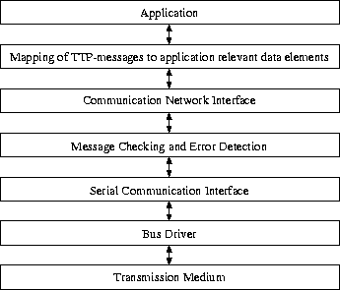
Protocol Layer in TTP/A
TimeTriggeredProtocol.ppt

Slide 19
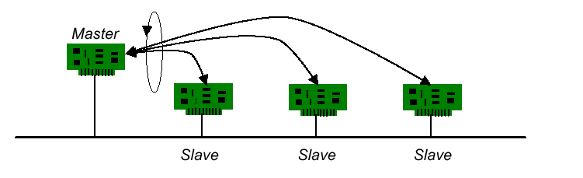
Polling
Operation
  Master polls the other nodes (slaves)
  Non-master nodes transmit messages when they are polled
  Inter-slave communication through the master
TimeTriggeredProtocol.ppt

Slide 20
Poll Tradeoff
Advantage
  Simple protocol to implement
  Historically very popular
  Bounded latency for real-time applications
Disadvantage
  Single point of failure from centralized master
  Polling consumes bandwidth
  Network size is fixed during installation(or master must discover nodes during reconfiguration)
TimeTriggeredProtocol.ppt

Slide 21
TTP/C
TTP/C
  A time-triggered communication protocol for safety-critical (fault-tolerant) distributed real-time control systems
  Based on a TDMA(Time Division Multiple Access) media access strategy
  Based on clock synchronization
TimeTriggeredProtocol.ppt

Slide 22
TTP/C
Some Concepts
CNI
  Communication Network Interface: interface between communication controller and the host computer within a node of a distributed system
Composability
  various components of a software system can be developed independently and integrated at a late stage of software development
Fail Silence
  A subsystem is fail-silent if it either produces correct results or no results at all, i.e., it is quiet in case it cannot deliver the correct service
FTU
  Fault-Tolerance Unit
SRU
  Smallest Replaceable Unit
TimeTriggeredProtocol.ppt

Slide 23
TTP/C Protocol Layer
Host Layer
Application software in Host
FTU CNI
FTU Layer
FTU Membership
Basic CNI
RM Layer
Redundancy Management
SRU Membership
Clock Synchronization
SRU Layer
Data Link/Physical Layer
Media Access: TDMA
TimeTriggeredProtocol.ppt

Slide 24
(Contd.)
Data Link/Physical Layer
  Provide the means to exchange frames between the nodes
SRU Layer
  Store the data fields of the received frames
RM Layer
  Provide the mechanisms for the cold start of a TTP/C cluster
FTU Layer
  Group two or more nodes into FTUs
Host Layer
  Provide the application software
Basic CNI
  A data-sharing interface between the RM layer and FTU layer
FTU CNI
  The interface between FTU layer and Host Layer
TimeTriggeredProtocol.ppt

Slide 25
Objectives in TTP/C
Precise Interface Specifications
Composability
Reusability of Components
Improved Supplier/Sub-supplier Relationship
Timeliness
Error Containment
Constructive Testability
Seamless Integration of Fault-Tolerance
Simpler Application Software
Shorter Time-to-Market
Reduced Development Costs
Reduced Maintenance Costs
TimeTriggeredProtocol.ppt

Slide 26
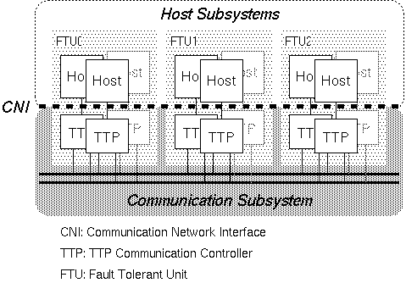
Structure of TTP/C System
TimeTriggeredProtocol.ppt

Slide 27
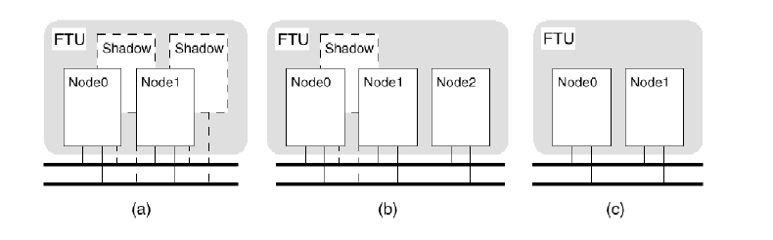
FTU in TTP/C
FTU Configuration Examples
Two active nodes, two shadow nodes
Three active nodes with one shadow nodes (Triple modular Redundancy)
Two active nodes without a shadow node
TimeTriggeredProtocol.ppt

Slide 28
Single Node Configuration
Includes controller to run protocol
DPRAM (dual ported RAM)
  To implement memory-mapped network interface
BG (Bus Guard)
  Hardware watchdog to ensure “fail silent”
Real chips must use highly accurate time sources
  Even dual redundant crystal oscillators as used in DATAC for Boeing 777)
TimeTriggeredProtocol.ppt

Slide 29
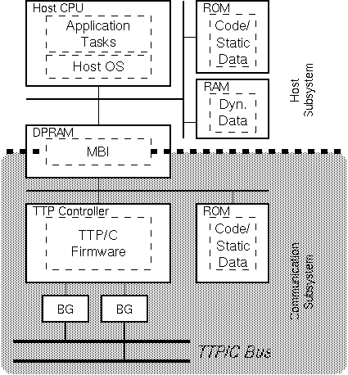
TTP/C
Single Node Configuration
TimeTriggeredProtocol.ppt

Slide 30
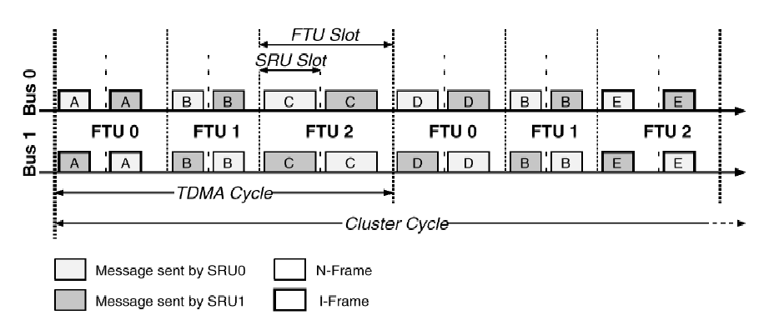
Cycle in TTP/C
TDMA Cycle
  One FTU sends results twice
  Then next FTU sends some results
  And so on, until back to the next message from the first FTU
Cluster Cycle
  Cluster cycle involves scheduling all possible message and tasks
TimeTriggeredProtocol.ppt

Slide 31
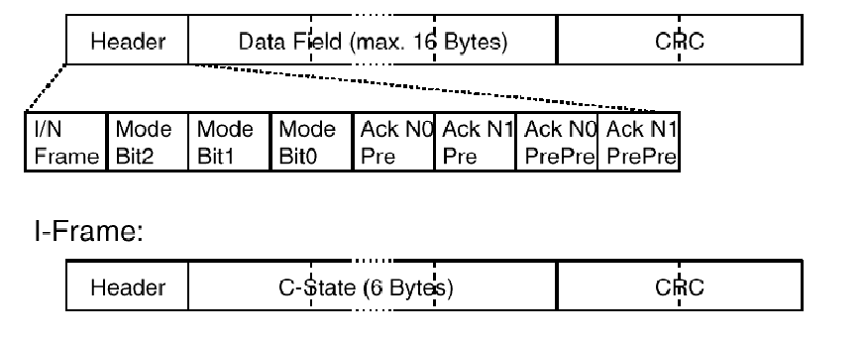
TTP/C Frame
I-Frames used for initialization
N-Frames used for normal messages
TimeTriggeredProtocol.ppt

Slide 32
Pros and Cons of TTP
Advantage
  Simple protocol to implement
  Deterministic response time
  No wasted time for Master polling message
Disadvantage
  Single point of failure from the bus master
  Wasted bandwidth when some nodes are idle
  Stable clocks
  Fixed network size during installation
TimeTriggeredProtocol.ppt

Slide 33
A comparison TTP/A vs. TTP/C
Service
TTP/A
TTP/C
Clock Synchronization
Central
Multimaster
Distributed,
Fault-Tolerant
Mode Switches
yes
yes
Communication Error Detection
Parity
16/24 bit CRC
Membership Service
simple
full
External Clock Synchronization
yes
yes
Time-Redundant Transmission
yes
yes
Duplex Nodes
no
yes
Duplex Channels
no
yes
Redundancy Management
no
yes
Shadow Node
no
yes

Slide 34
TTP/C + TTP/A
TTP/A is intended for low cost
TTPnode implements such an integrated TTP/C and TTP/A solution to carry out all sensing and actuating action within hard real-time deadlines and minimal jitter
(Jitter: The jitter is the difference between the maximum and the minimum duration of an action (processing action, communication action) )
TimeTriggeredProtocol.ppt

Slide 35
TTTech – Time Triggered Technology
TTTech Evaluation Cluster -- TTP Hardware Systems
  TTP Hardware Products
    TTPnode
  TTP Software Products – TTP tools
    TTPplan
    TTPbuild
    TTPos
    TTPView
    TTPload
TimeTriggeredProtocol.ppt

Slide 36
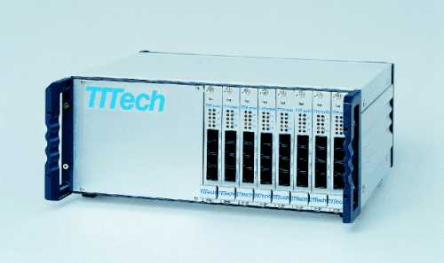
TTP Evaluation Cluster

Slide 37
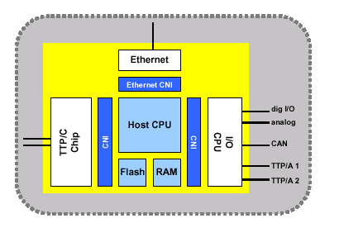
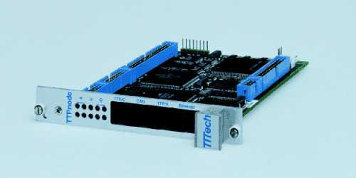
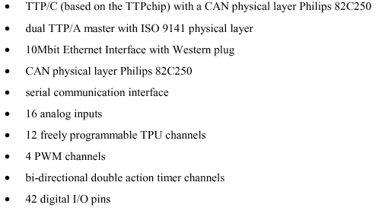
TTPnode

Slide 38
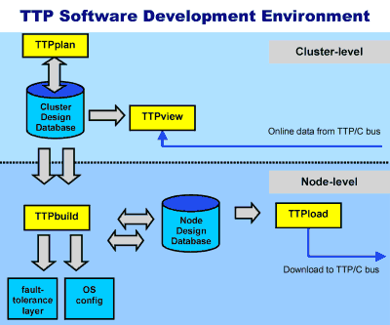

Slide 39
(Contd.)
TTPplan
A comprehensive tool for the design of TTP clusters based on the concepts of state messages and temporal firewalls
TTPbuild
An environment for the design of nodes in a TTP cluster
TTPos
The Time-Triggered Architecture and the TTP/C communication protocol, with fault-tolerance
TTPview
An easy-to-use graphical user interface which monitors the real-time messages among nodes
TTPload
An easy-to-use graphical user interface which allows to create and maintain download collections

Slide 40
Demonstration
TTP
Specification
  Controller and cluster communication startup
  Basic communication with TTP/C
  Basic FT layer features like host lifesign and message handing
  Building a replica determinate task
  Re-integration of a replica using h-state messages
  Checking the current degree of redundancy of a message
  Reacting to sporadic events in a time-triggered architecture

