Slide 1
Vehicle Informatics
(Vehicle System Informatics)
Lecture
Part 03
(CAN cont’d, LIN, MOST)
Dr. Tamás Szakács: szakacs.tamas@bgk.uni-obuda.hu,
Ákos Jányoki: janyoki.akos@bgk.uni-obuda.hu

Slide 2
CAN Automotive Applications
The modern automobile may have as many as 70 electronic control units (ECU) for various subsystems.
Typically the biggest processor is the engine control unit. Others are used for transmission, airbags, antilock braking/ABS, cruise control, electric power steering, audio systems, power windows, doors, mirror adjustment, battery and recharging systems for hybrid/electric cars, etc.
Some of these form independent subsystems, but communications among others are essential. A subsystem may need to control actuators or receive feedback from sensors. The CAN standard was devised to fill this need.
One key advantage is that interconnection between different vehicle systems can allow a wide range of safety, economy and convenience features to be implemented using software alone - functionality which would add cost and complexity if such features were "hard wired" using traditional automotive electrics.
https://en.wikipedia.org/wiki/CAN_bus

Slide 3
CAN Automotive Applications
Examples include:
Auto start/stop: Various sensor inputs from around the vehicle (speed sensors, steering angle, air conditioning on/off, engine temperature) are collated via the CAN bus to determine whether the engine can be shut down when stationary for improved fuel economy and emissions.
Electric park brakes: The "hill hold" functionality takes input from the car's tilt sensor (also used by the burglar alarm) and the road speed sensors (also used by the ABS, engine control and traction control) via the CAN bus to determine if the car is stopped on an incline. Similarly, inputs from seat belt sensors (part of the airbag controls) are fed from the CAN bus to determine if the seat belts are fastened, so that the parking brake will automatically release upon moving off.
https://en.wikipedia.org/wiki/CAN_bus

Slide 4
CAN Automotive Applications
Parking assist systems: when the driver engages reverse gear, the transmission control unit can send a signal via the CAN bus to activate both the parking sensor system, and the door control module for the passenger side door mirror to tilt downwards to show the position of the curb. The CAN bus also takes inputs from the rain sensor to trigger the rear windscreen wiper when reversing.
Auto lane assist/collision avoidance systems: The inputs from the parking sensors are also used by the CAN bus to feed outside proximity data to driver assist systems such as Lane Departure warning, and more recently, these signals travel through the CAN bus to actuate brake by wire in active collision avoidance systems.
https://en.wikipedia.org/wiki/CAN_bus

Slide 5
CAN Automotive Applications
Auto brake wiping: Input is taken from the rain sensor (used primarily for the automatic windscreen wipers) via the CAN bus to the ABS module to initiate an imperceptible application of the brakes whilst driving to clear moisture from the brake rotors. Some high performance Audi and BMW models incorporate this feature.
In recent years, the LIN bus standard has been introduced to complement CAN for non-critical subsystems such as air-conditioning and infotainment, where data transmission speed and reliability are less critical.
https://en.wikipedia.org/wiki/CAN_bus

Slide 6
CAN Architecture
JInfo_EA_kommunikacio-BME.pdf

Slide 7
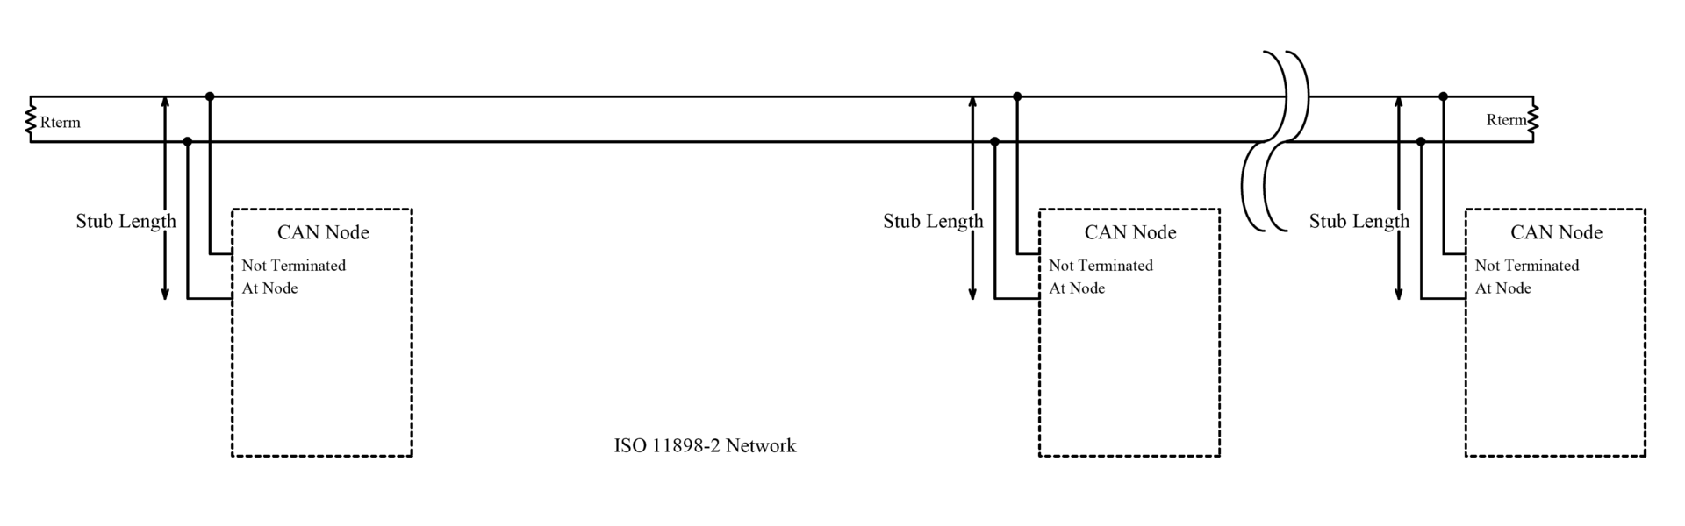
CAN Architecture
CAN is a multi-master serial bus standard for connecting Electronic Control Units [ECUs] also known as nodes. Two or more nodes are required on the CAN network to communicate. The complexity of the node can range from a simple I/O device up to an embedded computer with a CAN interface and sophisticated software. The node may also be a gateway allowing a standard computer to communicate over a USB or Ethernet port to the devices on a CAN network.
All nodes are connected to each other through a two wire bus. The wires are a twisted pair with a 120Ω (nominal) characteristic impedance.
ISO 11898-2, also called high speed CAN, uses a linear bus terminated at each end with 120Ω resistors.
https://en.wikipedia.org/wiki/CAN_bus

Slide 8
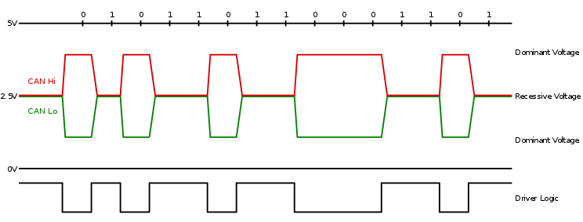
CAN Architecture
High speed CAN signaling drives the CAN high wire towards 5V and the CAN low wire towards 0V when transmitting a dominant (0), and does not drive either wire when transmitting a recessive (1). The dominant differential voltage is a nominal 2V. The termination resistor passively returns the two wires to a nominal differential voltage of 0V. The dominant common mode voltage must be within 1.5 to 3.5V of common and the recessive common mode voltage must be within +/-12 of common.

Slide 9
CAN Architecture

Slide 10
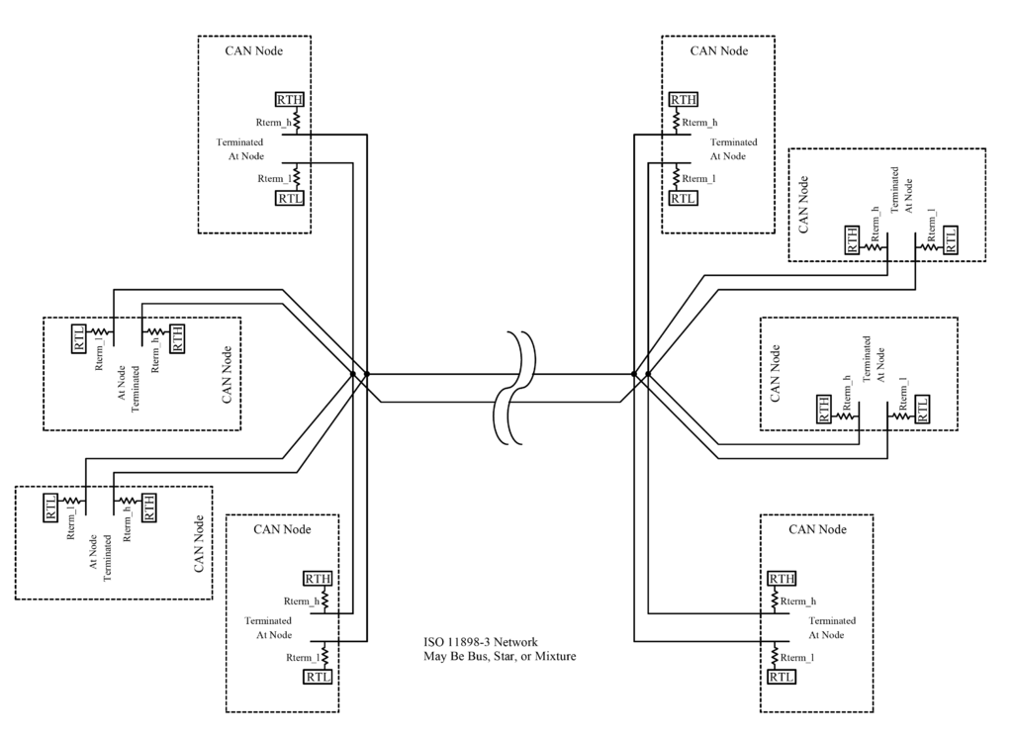
CAN Architecture
ISO 11898-3, also called low speed or fault tolerant CAN, uses a linear bus, star bus or multiple star buses connected by a linear bus and is terminated at each node by a fraction of the overall termination resistance. The overall termination resistance should be about 100 Ω, but not less than 100 Ω.

Slide 11
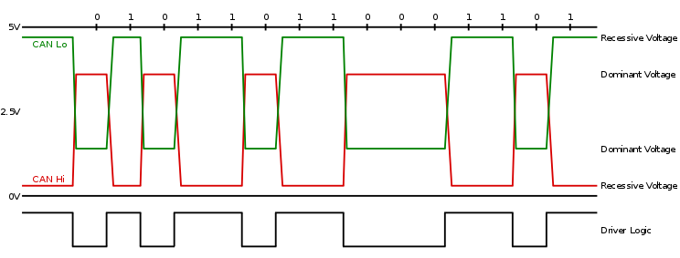
CAN Architecture

Slide 12
Can BUS system
JInfo_EA_kommunikacio-BME.pdf
ÓE-BGK MEI Vehicle Informatics Dr. Tamás Szakács

Slide 13
Can BUS system
Why twisted pair cable?
JInfo_EA_kommunikacio-BME.pdf
ÓE-BGK MEI Vehicle Informatics Dr. Tamás Szakács

Slide 14
Can BUS system
Arbitration race
JInfo_EA_kommunikacio-BME.pdf
ÓE-BGK MEI Vehicle Informatics Dr. Tamás Szakács

Slide 15
Can BUS system
JInfo_EA_kommunikacio-BME.pdf
ÓE-BGK MEI Vehicle Informatics Dr. Tamás Szakács

Slide 16
Can BUS system
JInfo_EA_kommunikacio-BME.pdf
ÓE-BGK MEI Vehicle Informatics Dr. Tamás Szakács

Slide 17
Can BUS system
JInfo_EA_kommunikacio-BME.pdf
ÓE-BGK MEI Vehicle Informatics Dr. Tamás Szakács

Slide 18
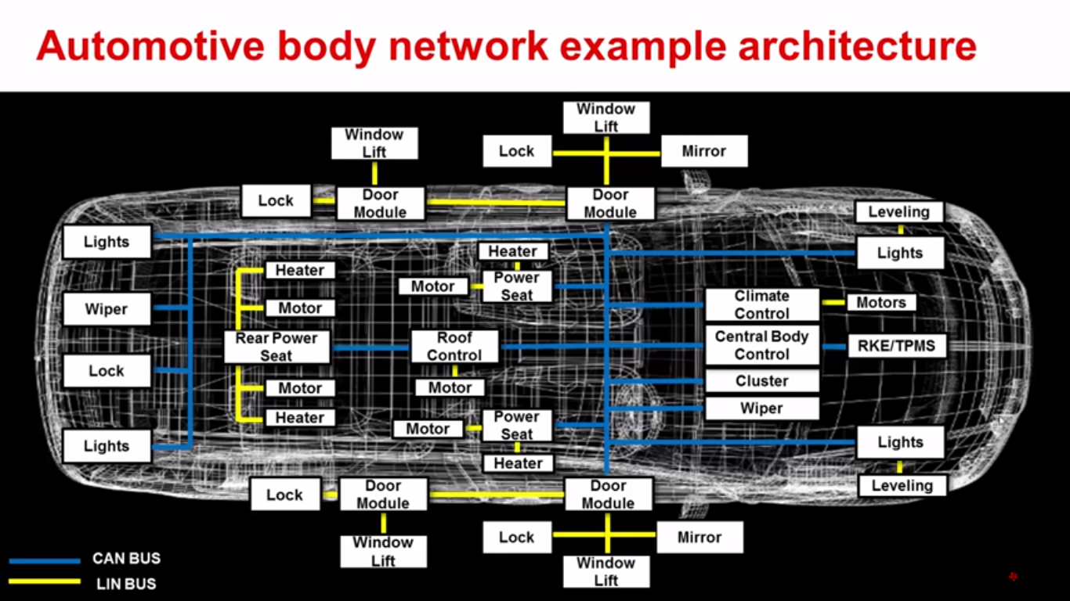
CAN BUS Detailed and LIN
click to start the video
Automotive CAN and LIN Overview (Texas Instruments)

Slide 19
LIN (Local Interconnect Network)
The LIN Consortium started as workgroup in late 1998 as an initiative by the five car manufacturers Audi, BMW, DaimlerChrysler, Volvo and Volkswagen, the tool manufacturer VCT, and the semiconductor manufacturer Motorola.
The objective of this workgroup is the specification of an open standard for low-cost local interconnect networks (LIN) in vehicles where the bandwidth and versatility of CAN are not required. Typical applications for LIN are smart sensors and actuators that require data communication from and to a network.
[1] J. W. Specks, A. Rajnák,
“LIN - Protocol, Development Tools, and Software Interfaces for Local Interconnect Networks in Vehicles“,
9th International Conference on Electronic Systems for Vehicles, Baden-Baden, Oct. 5/6, 2000

Slide 20
LIN (Local Interconnect Network)
The LIN standard [1] specifies not only the data transmission but also gives provision for a highly automated tool chain. It addresses the needs of increasing complexity, implementation, and maintenance of software in distributed systems. For this reason the LIN specification covers in addition to the definition of protocol and medium also the interfaces for the development tools and for a network-independent application software.
The communication is based on the SCI (UART) data format, a single-master/multiple-slave concept, a single wire 12V bus, and a clock synchronization for nodes without stabilized time base. The LIN specification is open and is driven by an automotive industry consortium.
[1] J. W. Specks, A. Rajnák,
“LIN - Protocol, Development Tools, and Software Interfaces for Local Interconnect Networks in Vehicles“,
9th International Conference on Electronic Systems for Vehicles, Baden-Baden, Oct. 5/6, 2000

Slide 21
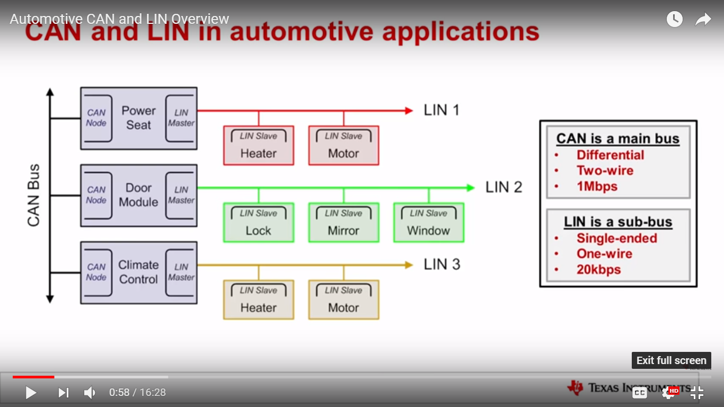
CAN and LIN BUS systems
Automotive CAN and LIN Overview (Texas Instruments)

Slide 22
LIN
JInfo_EA_kommunikacio-BME.pdf

Slide 23
What is LIN
click to start the video

Slide 24
LIN Summarized
In its simplest form a LIN network consist of a LIN master and a LIN slave.
Data is exchanged and capsulated in data frames with a fixed structure, which always contain:
  a break field, that indicates a new incoming frame
  a sync field that allows the slave to synchronize on the master clock
  a message ID field from which the slave knows how to interpret the forthcoming data
  a data field containing the communicated data bytes
  a checksum ensuring correct reception of the data frame
melexis.com

Slide 25
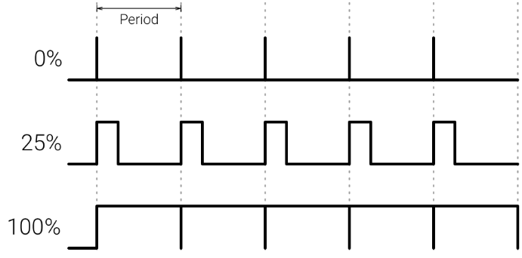
LIN Summarized
Two types of message can be distinguished.
  Transmit frames which contain data sent from the master to the slave
  Response frames which contain data sent from the Slave to the master
In both cases the head of that containing break, sync and message ID is generated by the master.
The data part including the checksum could be generated by the master or slave depending on whether it's a transmitted or a received frame.
Example: a LIN based switch module has to communicate the switch status open or closed information to the master. The master informs the switch module of the applicable PWM value for the indicator LED.
melexis.com
Pulse Width Modulation (PWM)

Slide 26
LIN Summarized
Each LIN master has a schedule table, that defines the sequence of messages that would be transmitted on the LIN bus.
Typically messages are transmitted at a fixed interval. The so-called tic time at 20K board using frames with 4 data byte, the tic time is 5 milliseconds.
In this example the schedule table consists of two messages:
  one response frame that contains the switch status information and
  a transmit frame that contains the PWM value to set the brightness of the LED.
melexis.com

Slide 27
LIN Summarized
The master runs continuously through the schedule table. When the switch is pressed, the slave will convert this physical action into a bit value in a register. When the master sends out the message ID of the response frame the slave will put the content of this register into the data byte.
The master will update the PWM value for the function light in the next transmit frame. The slave will update it's LED driver output accordingly. As long as the switch status register in the slave remains one the corresponding bit in the response message remains one as well. When the switch is released the register will be reset to zero and the data in the next response frames will be zero as well.
As long as the master does not update the LED PWM information the LED remains on. In real life this whole process runs so fast, that the user experiences instant reaction.
melexis.com

Slide 28
LIN Video Summarized
A typical switch model consists of multiple switches and LEDs which are all controlled from the same LIN slave.
One slave can have multiple transmit and receive frames.
The LIN master can manage up to 16 slaves on one bus.
The message ID field will be fine which of the slaves were reacted to the transmitted message.
Typical LIN masters of
  the door module
  the steering wheel module
  the HVAC controller (heating and/or air conditioning system) and
  the smart junction box
When the schedule table becomes too long or if the number of slaves is too big, one LIN master can also control multiple LIN buses.
melexis.com

Slide 29
LIN Video Summarized
A major benefit of the simplicity of the LIN network is that software development can be avoided. Simple LIN slaves that actors IR extensions in switch modules, can be configured quickly and simply by the configuring the data is quern from during end-of-line programming.
Example 1. : steering wheel switch module:
The I/Os of the LIN slave are configured for 4 single switches to ground, 2 rotating encoders, 3 PWM outputs for functional lights so back lighting and 1 analogue input. The switch debounce time is set to 20 milliseconds.
A first slave to master message is configured with 4 data bytes, which information is assigned to byte 0, the analogue input is assigned to byte 1. And the rotating encoder values are assigned to bytes 2 and 3. A second master to slave message is configured with 4 data bytes, that are configured for receiving the three PWM duty cycle values.
melexis.com

Slide 30
LIN Video Summarized
Example 2.
  A door switch module the LIN slave can be configured to read more than 20 switches in a matrix.
  The LIN slave can wake up the LIN bus, when any of the switches is pressed.
  Avoiding software development, also implies guaranteed quality without software validation and qualification. The LIN standard allows vehicle manufacturers to add functionality and extend comfort packs with a minimum of development cost, and to react faster to the new requests on the market.
melexis.com

Slide 31
LIN Example
LIN case study with mechatronic seat, mirror, and steering nodes
w_specks_lin_baden-baden_paper[1].pdf

Slide 32
Local Interconnect Network (LIN)
JInfo_EA_kommunikacio-BME.pdf

Slide 33
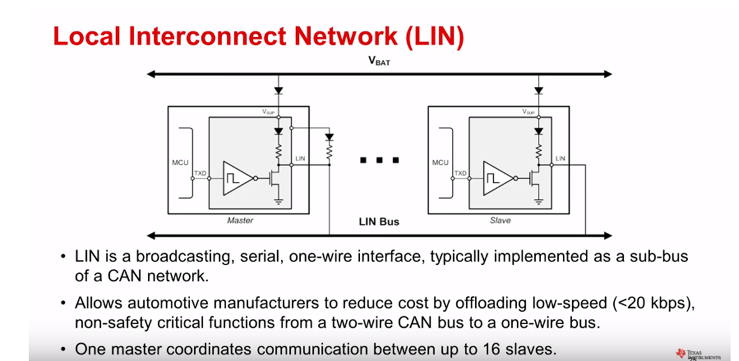
Local Interconnect Network (LIN)
Automotive CAN and LIN Overview (Texas Instruments)

Slide 34
LIN
JInfo_EA_kommunikacio-BME.pdf

Slide 35
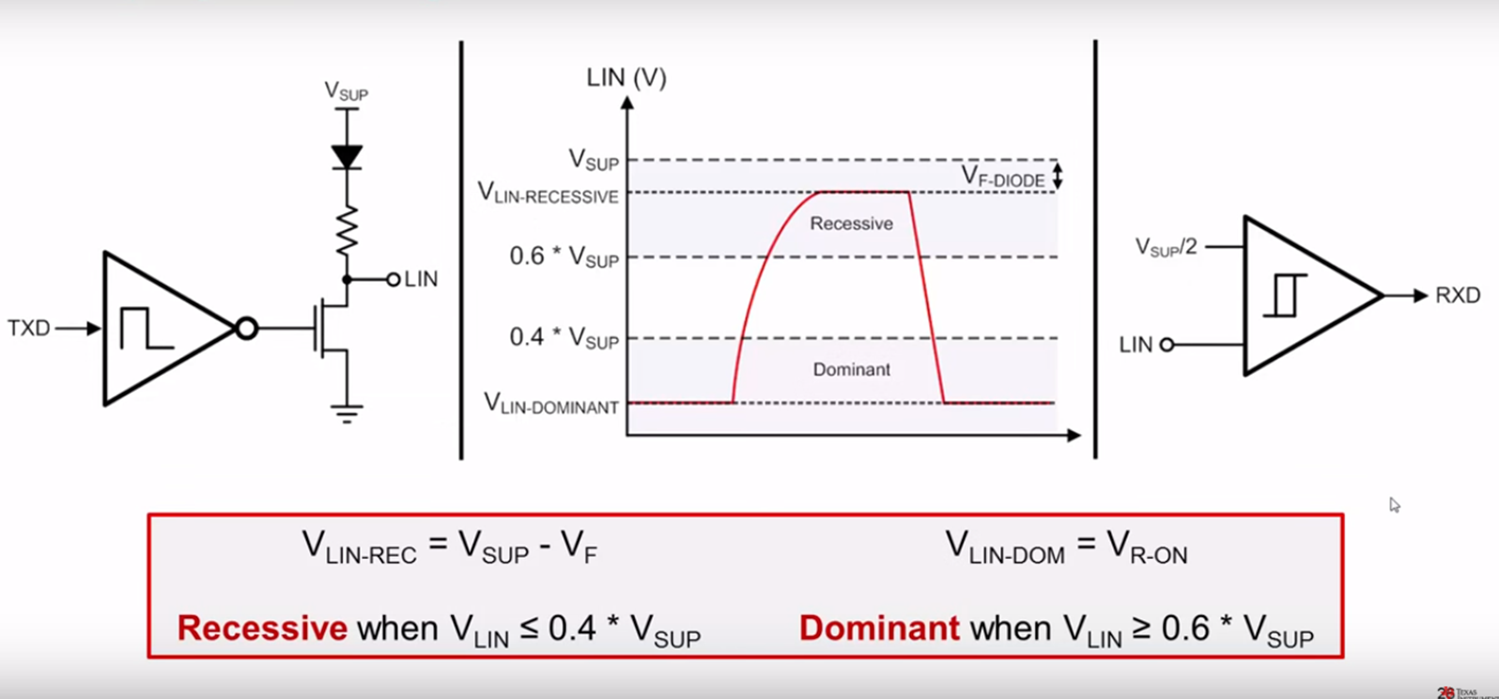
LIN Physical Layer
Automotive CAN and LIN Overview (Texas Instruments)

Slide 36
LIN
Networking and tool interfaces for LIN
w_specks_lin_baden-baden_paper[1].pdf

Slide 37
MOST (Media Oriented Systems Transport)
A high-speed multimedia network technology optimized by the automotive industry. Can be used for applications inside or outside the car.
JInfo_EA_kommunikacio-BME.pdf

Slide 38
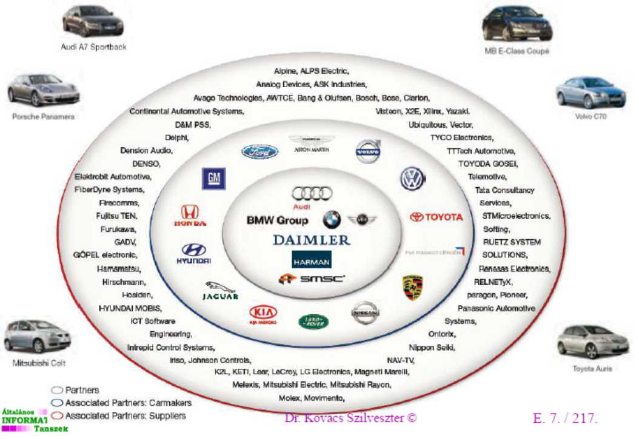
MOST (Media Oriented Systems Transport)
MOST technology is used in almost every car brand worldwide, including Audi, BMW, General Motors, Hyundai, Jaguar, Lancia, Land Rover, Mercedes-Benz, Porsche, Toyota, Volkswagen, SAAB, SKODA, SEAT and Volvo. SMSC and MOST are registered trademarks of Standard Microsystems Corporation (“SMSC”), now owned by Microchip Technology.
JInfo_EA_kommunikacio-BME.pdf

Slide 39
MOST
MOST is a synchronous network.
  A timing master supplies the clock with a synchronous and continuous data signal
  All other devices synchronize their operation to this base signal.
This technology eliminates the need for buffering and sample rate conversion
  Very simple and inexpensive devices can be connected
  The hardware of the network interface itself is lean and cost effective.
The technology is similar to what the public switched telephone network uses.
mostcooperation.com

Slide 40
MOST
Within the synchronous base data signal,
  multiple streaming data channels
  one control channel are transported.
The control channel is used to set up what streaming data channels the sender and receiver are to use. Once the connection is established, data can flow continuously and no further addressing or processing of packet label information is required.
The bandwidth of the streaming data channels is always available and reserved for the dedicated stream so there are no interruptions, collisions, or slow-downs in the transport of the data stream. This is the optimum mechanism for delivering streaming data (information that flows continuously) like audio and video. MOST has been designed for high quality of service and cost effective transport of audio and video.
mostcooperation.com

Slide 41
MOST
Sending asynchronous, packet based data in addition to the control channel and the streaming data
  Runs on top of the permanent synchronous data signal
  Completely separate from the control channel and the streaming data channels so that none of them interfere with each other
  for computer based data, such as Internet traffic or information from a navigation system, is typically sent in short (asynchronous) bursts as packets and is often going to many different places
mostcooperation.com

Slide 42
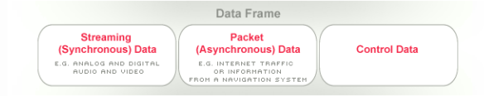
MOST
MOST is a multiplex network that has different channels with their own mechanisms to transport all the various signals and data streams that occur in multimedia and infotainment systems.
They all run on top of a synchronous base data stream which guarantees high quality of service for the audio and video signals where disturbances are not acceptable.
mostcooperation.com

Slide 43
Key Features MOST
Ease of use
  Simple connectors
  No hum loops, no radiation
  Plug-n-Play; self identifying devices with auto initialization
  Dynamically attachable and re-configurable devices
  Virtual network management including channel allocation, system monitoring addressing and power management
mostcooperation.com

Slide 44
Key Features MOST
Wide application range
  applications with varied bandwidth requirements
  high degree of data integrity with low jitter
  support of asynchronous and synchronous data transfer
  support of multiple masters
  supports up to 64 devices
  simultaneous transmission of multiple data streams such as control, packet and real-time information
  devices can be constructed out of multiple functions
  low overhead due to embedded network management
mostcooperation.com

Slide 45
Key Features MOST
Synchronous bandwidth
  synchronous channels provide guaranteed bandwidth with no buffering required
Asynchronous bandwidth
  variable asynchronous bandwidth with additional dedicated real-time control channels
mostcooperation.com

Slide 46
Key Features MOST
Flexibility
  wide range of real-time channel sizes and packet sizes
  remote operation and flow control
  variable asynchronous bandwidth with additional dedicated real-time control channels
  protocol independent
mostcooperation.com

Slide 47
Key Features MOST
Synergy with Consumer and PC Industries
  operates with or without PC
  consistent with PC streaming
Low Implementation Cost
  low cost channel to distribute control information without extra wiring
  zero data overhead to move synchronous data after a connection is established
  synchronous channels eliminate the need for buffering and sample rate conversion
  suitable for embedding in consumer devices and peripherals
  cost-effective electrical and optical solutions
  inexpensive silicon from many suppliers
mostcooperation.com

Slide 48
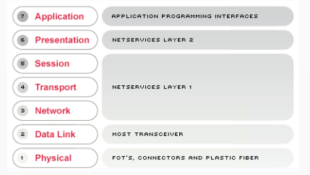
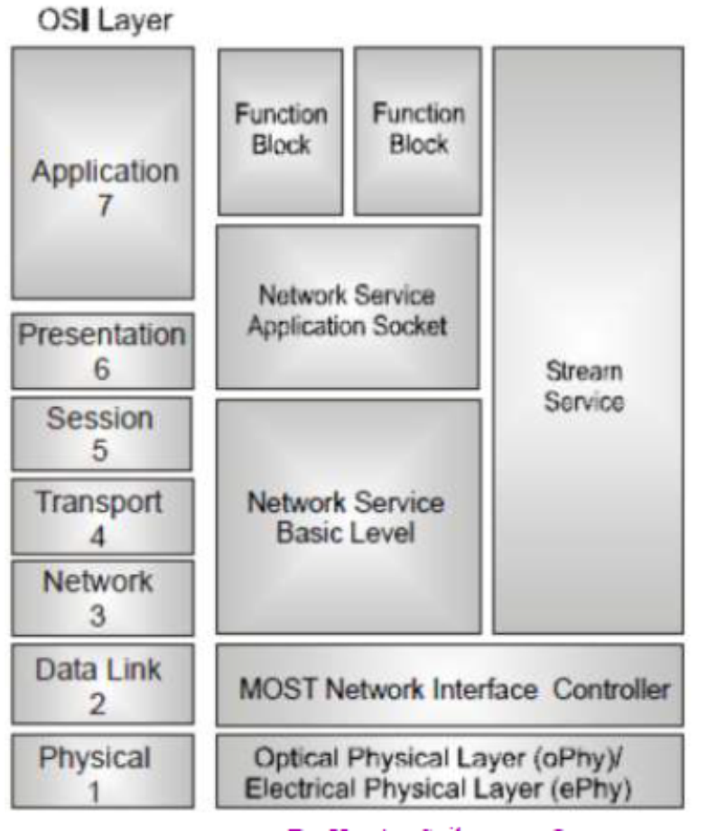
OSI / ISO MOST
mostcooperation.com
JInfo_EA_kommunikacio-BME.pdf

Slide 49
MOST
JInfo_EA_kommunikacio-BME.pdf

Slide 50
MOST
JInfo_EA_kommunikacio-BME.pdf

Slide 51
MOST
JInfo_EA_kommunikacio-BME.pdf

Slide 52
MOST
JInfo_EA_kommunikacio-BME.pdf

Slide 53
MOST
JInfo_EA_kommunikacio-BME.pdf

