Slide 1
Vehicle Informatics
(Vehicle System Informatics)
Lecture
Part 02
Dr. Tamás Szakács: szakacs.tamas@bgk.uni-obuda.hu,
Ákos Jányoki: janyoki.akos@bgk.uni-obuda.hu

Slide 2
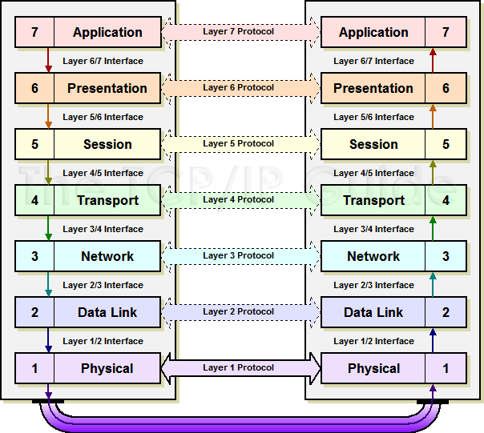
ISO/OSI 7 layers model
The Open Systems Interconnection model (OSI model) is a conceptual model that characterizes and standardizes the communication functions of a telecommunication or computing system without regard to their underlying internal structure and technology. Its goal is the interoperability of diverse communication systems with standard protocols. The model partitions a communication system into abstraction layers. The original version of the model defined seven layers.
ÓE-BGK MEI Vehicle Informatics Dr. Tamás Szakács

Slide 3
Bus Access Methods
There are various methods of collision avoidance between the various fieldbus systems and in most cases the collision avoidance is actually a collision “repair”, which requires an unspecified bus recovery time, therefore taking up valuable bandwidth, and usually results in the destruction of the message.
Random access: - The „workstation (WS)” is randomly checking the BUS state, and if the BUS is not busy can initiate the transmit. (CSMA/CD)
Distributed access: Just one „workstation” has the ability to transmit. This ability is passed (after the determined time-period) from WS to WS (CSMA/CA)
Centralized access: a central „station” controlling the BUS accesses. The other WSs listening for permit to transfer. (TDMA, Master-Slave)
ÓE-BGK MEI Vehicle Informatics Dr. Tamás Szakács

Slide 4
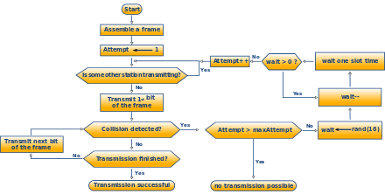
Bus Access Methods CSMA/CD
(CSMA/CD) is a media access control method used most notably in local area networking using early Ethernet technology. It uses a carrier sensing scheme in which a transmitting data station detects other signals while transmitting a frame, and stops transmitting that frame, transmits a jam signal, and then waits for a random time interval before trying to resend the frame.
ÓE-BGK MEI Vehicle Informatics Dr. Tamás Szakács

Slide 5
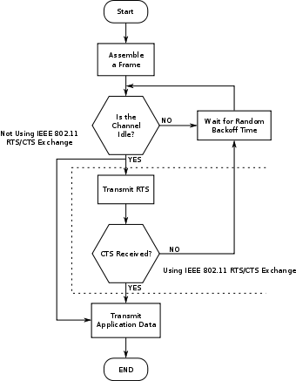
Bus Access Methods
CSMA/CA
Carrier sense multiple access with collision avoidance (CSMA/CA) in computer networking, is a network multiple access method in which carrier sensing is used, but nodes attempt to avoid collisions by transmitting only when the channel is sensed to be "idle"
ÓE-BGK MEI Vehicle Informatics Dr. Tamás Szakács

Slide 6
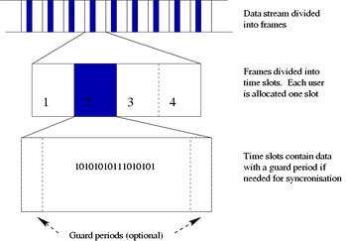
Bus Access Methods
TDMA
Time division multiple access (TDMA) is a channel access method for shared medium networks. It allows several users to share the same frequency channel by dividing the signal into different time slots. The users transmit in rapid succession, one after the other, each using its own time slot. This allows multiple stations to share the same transmission medium (e.g. radio frequency channel) while using only a part of its channel capacity.
ÓE-BGK MEI Vehicle Informatics Dr. Tamás Szakács

Slide 7
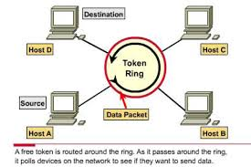
Bus Access Methods
Token Passing
In telecommunication, token passing is a channel access method where a signal called a token is passed between nodes that authorizes the node to communicate. The most well-known examples are token ring and token bus.
Token Passing
Token Ring
Token Bus
It uses a special three-byte frame called a "token" that travels around a physical "ring" of workstations or servers.
ÓE-BGK MEI Vehicle Informatics Dr. Tamás Szakács

Slide 8
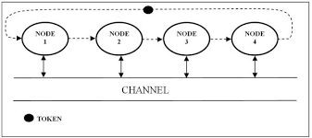
Token Passing
Token Ring
Token Bus
It uses a special three-byte frame called a "token" that travels around a logical "ring" of workstations or servers.
ÓE-BGK MEI Vehicle Informatics Dr. Tamás Szakács

Slide 9
Serial Communication
Serial communication is the process of sending data one bit at a time, sequentially, over a communication channel or computer bus.
This is in contrast to parallel communication, where several bits are sent as a whole, on a link with several parallel channels.
Features:
Baud rates
Physical features:
  Transfer medium (WiFi, Opto-cabel, wired pair, coax)
  Transfer mode (analogue/digital/ wide-broadband)
  Direction of transfer (simplex/duplex/half-duplex)
Coding (Manchester –edge coding)
Synchronizing (synchronous/asynchronous)
Transfer validity checking (parity bites, CRC)
ÓE-BGK MEI Vehicle Informatics Dr. Tamás Szakács

Slide 10
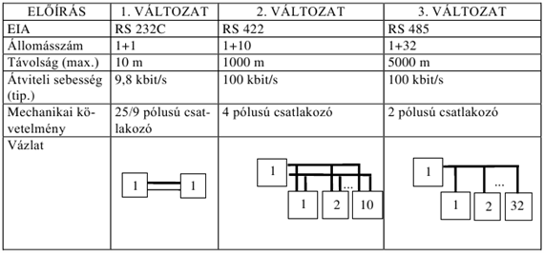
Most important Serial Communication’s standards
RS 232C/422/485
EIA | RS 232C | RS 422 | RS 485
Nr. of WSs | 1+1 | 1+10 | 1+32
Distance | 10 m | 1000 m | 5000 m
Baud Rate | 9,8 kbit/s | 100 kbit/s | 100 kbit/s
Interface (connectors) | 9/25 pins connector (serial port-connector) | 4 pins connector | 2 poles connector
Scheme:
ÓE-BGK MEI Vehicle Informatics Dr. Tamás Szakács

Slide 11
Master-Slave Communication
Master/slave is a model of communication where one device or process has unidirectional control over one or more other devices. In some systems a master is selected from a group of eligible devices, with the other devices acting in the role of slaves.
In computing, bus mastering is a feature supported by many bus architectures that enables a device connected to the bus to initiate transactions. It is also referred to as "first-party DMA", in contrast with "third-party DMA" where a system DMA controller (also known as peripheral processor, I/O processor, or channel) actually does the transfer.
Some types of buses allow only one device (typically the CPU, or its proxy) to initiate transactions
ÓE-BGK MEI Vehicle Informatics Dr. Tamás Szakács

Slide 12
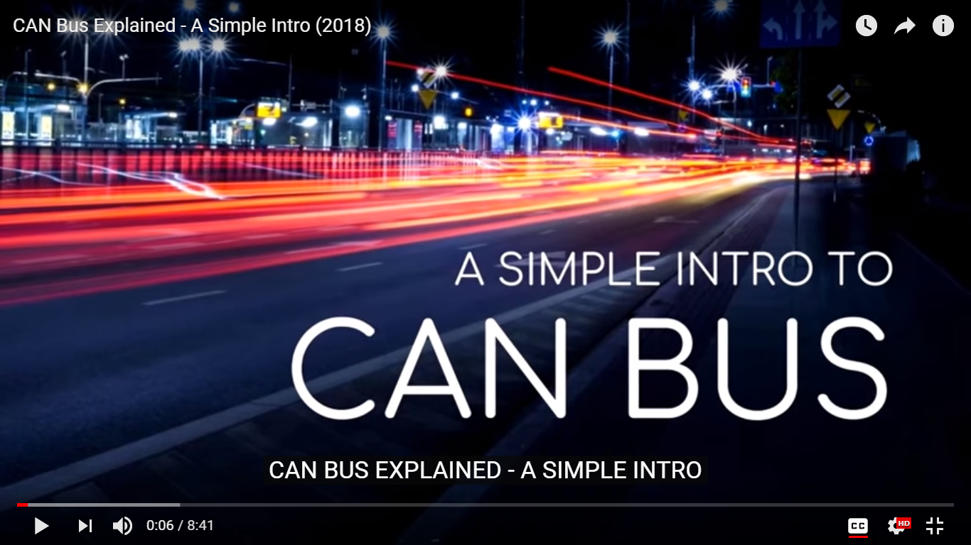
Can BUS system intro
Click on the screenshot to start!
ÓE-BGK MEI Vehicle Informatics Dr. Tamás Szakács

Slide 13
CAN History
A Controller Area Network (CAN bus) is a robust vehicle bus standard designed to allow microcontrollers and devices to communicate with each other in applications without a host computer. It is a message-based protocol, designed originally for multiplex electrical wiring within automobiles to save on copper, but is also used in many other contexts.
Development of the CAN bus started in 1983 at Robert Bosch GmbH The protocol was officially released in 1986 at the Society of Automotive Engineers (SAE) conference in Detroit, Michigan. The first CAN controller chips, produced by Intel and Philips, came on the market in 1987. Released in 1991 the Mercedes-Benz W140 was the first production vehicle to feature a CAN-based multiplex wiring system.
https://en.wikipedia.org/wiki/CAN_bus

Slide 14
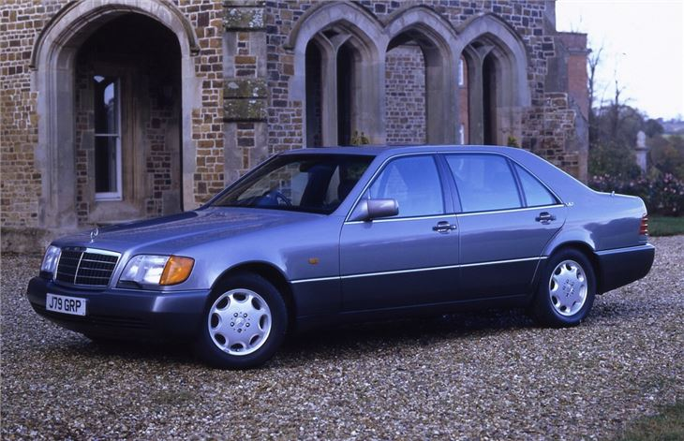
CAN History
https://images.honestjohn.co.uk/imagecache/file/fit/730x700/media/7518369/Mercedes~S-Class~(2).jpg

Slide 15
CAN 2.0
Bosch published several versions of the CAN specification and the latest is CAN 2.0 published in 1991. This specification has two parts;
part A is for the standard format with an 11-bit identifier, and
part B is for the extended format with a 29-bit identifier.
A CAN device that uses 11-bit identifiers is commonly called CAN 2.0A and a CAN device that uses 29-bit identifiers is commonly called CAN 2.0B.
These standards are freely available from Bosch along with other specifications.
https://en.wikipedia.org/wiki/CAN_bus

Slide 16
CAN ISO 11898
In 1993, the International Organization for Standardization (ISO) released the CAN standard ISO 11898 which was later restructured into two parts;
ISO 11898-1 which covers the data link layer, and
ISO 11898-2 which covers the CAN physical layer for high-speed CAN.
ISO 11898-3 was released later and covers the CAN physical layer for low-speed, fault-tolerant CAN.
The physical layer standards ISO 11898-2 and ISO 11898-3 are not part of the Bosch CAN 2.0 specification. These standards may be purchased from the ISO.
https://en.wikipedia.org/wiki/CAN_bus

Slide 17
CAN
Bosch is still active in extending the CAN standards.
In 2012, Bosch released CAN FD 1.0 or CAN with Flexible Data-Rate. This specification uses a different frame format that allows a different data length as well as optionally switching to a faster bit rate after the arbitration is decided.
CAN FD is compatible with existing CAN 2.0 networks so new CAN FD devices can coexist on the same network with existing CAN devices.
CAN bus is one of five protocols used in the on-board diagnostics (OBD)-II vehicle diagnostics standard.
The OBD-II standard has been mandatory for all cars and light trucks sold in the United States since 1996.
The EOBD standard has been mandatory for all petrol vehicles sold in the European Union since 2001 and all diesel vehicles since 2004.
https://en.wikipedia.org/wiki/CAN_bus

Slide 18
CAN Automotive Applications
The modern automobile may have as many as 70 electronic control units (ECU) for various subsystems.
Typically the biggest processor is the engine control unit. Others are used for transmission, airbags, antilock braking/ABS, cruise control, electric power steering, audio systems, power windows, doors, mirror adjustment, battery and recharging systems for hybrid/electric cars, etc.
Some of these form independent subsystems, but communications among others are essential. A subsystem may need to control actuators or receive feedback from sensors. The CAN standard was devised to fill this need.
One key advantage is that interconnection between different vehicle systems can allow a wide range of safety, economy and convenience features to be implemented using software alone - functionality which would add cost and complexity if such features were "hard wired" using traditional automotive electrics.
https://en.wikipedia.org/wiki/CAN_bus

Slide 19
CAN Automotive Applications
Examples include:
Auto start/stop: Various sensor inputs from around the vehicle (speed sensors, steering angle, air conditioning on/off, engine temperature) are collated via the CAN bus to determine whether the engine can be shut down when stationary for improved fuel economy and emissions.
Electric park brakes: The "hill hold" functionality takes input from the car's tilt sensor (also used by the burglar alarm) and the road speed sensors (also used by the ABS, engine control and traction control) via the CAN bus to determine if the car is stopped on an incline. Similarly, inputs from seat belt sensors (part of the airbag controls) are fed from the CAN bus to determine if the seat belts are fastened, so that the parking brake will automatically release upon moving off.
https://en.wikipedia.org/wiki/CAN_bus

Slide 20
CAN Automotive Applications
Parking assist systems: when the driver engages reverse gear, the transmission control unit can send a signal via the CAN bus to activate both the parking sensor system, and the door control module for the passenger side door mirror to tilt downwards to show the position of the curb. The CAN bus also takes inputs from the rain sensor to trigger the rear windscreen wiper when reversing.
Auto lane assist/collision avoidance systems: The inputs from the parking sensors are also used by the CAN bus to feed outside proximity data to driver assist systems such as Lane Departure warning, and more recently, these signals travel through the CAN bus to actuate brake by wire in active collision avoidance systems.
https://en.wikipedia.org/wiki/CAN_bus

Slide 21
CAN Automotive Applications
Auto brake wiping: Input is taken from the rain sensor (used primarily for the automatic windscreen wipers) via the CAN bus to the ABS module to initiate an imperceptible application of the brakes whilst driving to clear moisture from the brake rotors. Some high performance Audi and BMW models incorporate this feature.
In recent years, the LIN bus standard has been introduced to complement CAN for non-critical subsystems such as air-conditioning and infotainment, where data transmission speed and reliability are less critical.
https://en.wikipedia.org/wiki/CAN_bus

Slide 22
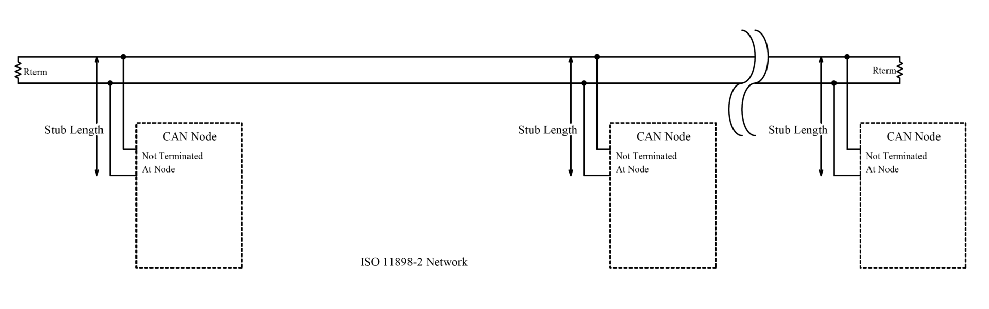
CAN Architecture
CAN is a multi-master serial bus standard for connecting Electronic Control Units [ECUs] also known as nodes. Two or more nodes are required on the CAN network to communicate. The complexity of the node can range from a simple I/O device up to an embedded computer with a CAN interface and sophisticated software. The node may also be a gateway allowing a standard computer to communicate over a USB or Ethernet port to the devices on a CAN network.
All nodes are connected to each other through a two wire bus. The wires are a twisted pair with a 120Ω (nominal) characteristic impedance.
ISO 11898-2, also called high speed CAN, uses a linear bus terminated at each end with 120Ω resistors.
https://en.wikipedia.org/wiki/CAN_bus

Slide 23
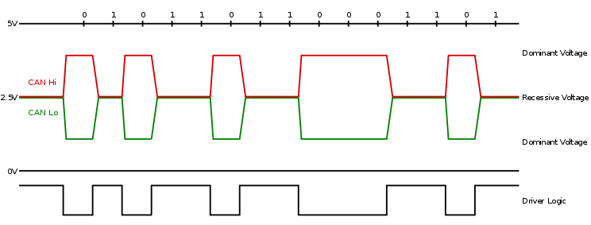
CAN Architecture
High speed CAN signaling drives the CAN high wire towards 5V and the CAN low wire towards 0V when transmitting a dominant (0), and does not drive either wire when transmitting a recessive (1). The dominant differential voltage is a nominal 2V. The termination resistor passively returns the two wires to a nominal differential voltage of 0V. The dominant common mode voltage must be within 1.5 to 3.5V of common and the recessive common mode voltage must be within +/-12 of common.

Slide 24
CAN Architecture

Slide 25
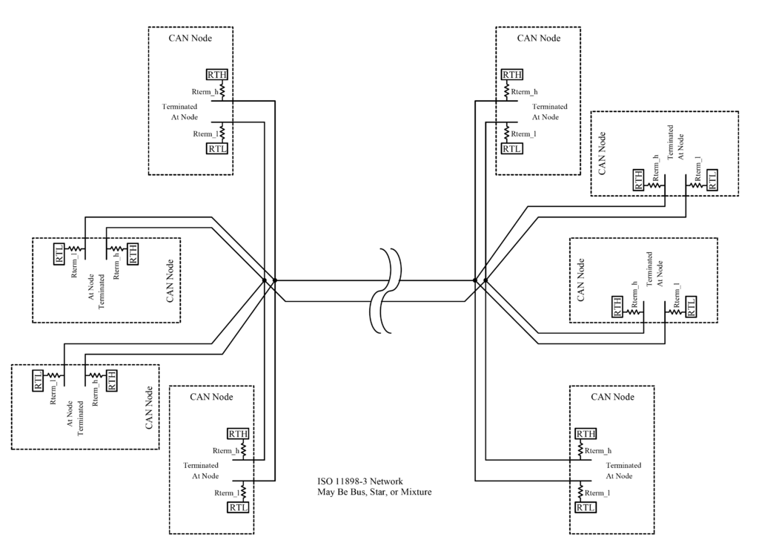
CAN Architecture
ISO 11898-3, also called low speed or fault tolerant CAN, uses a linear bus, star bus or multiple star buses connected by a linear bus and is terminated at each node by a fraction of the overall termination resistance. The overall termination resistance should be about 100 Ω, but not less than 100 Ω.

Slide 26
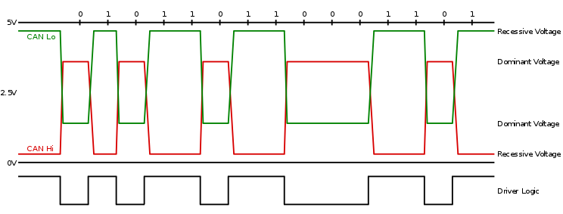
CAN Architecture

Slide 27
Can BUS system
JInfo_EA_kommunikacio-BME.pdf
ÓE-BGK MEI Vehicle Informatics Dr. Tamás Szakács

Slide 28
Can BUS system
Why twisted pair cable?
JInfo_EA_kommunikacio-BME.pdf
ÓE-BGK MEI Vehicle Informatics Dr. Tamás Szakács

Slide 29
Can BUS system
Arbitration race
JInfo_EA_kommunikacio-BME.pdf
ÓE-BGK MEI Vehicle Informatics Dr. Tamás Szakács

Slide 30
Can BUS system
JInfo_EA_kommunikacio-BME.pdf
ÓE-BGK MEI Vehicle Informatics Dr. Tamás Szakács

Slide 31
Can BUS system
JInfo_EA_kommunikacio-BME.pdf
ÓE-BGK MEI Vehicle Informatics Dr. Tamás Szakács

Slide 32
Can BUS system
JInfo_EA_kommunikacio-BME.pdf
ÓE-BGK MEI Vehicle Informatics Dr. Tamás Szakács

