Slide 1
Basics of Mechatronic I
Materials:
http://siva.banki.hu/~szakacs
Dr. -Ing. Tamás Szakács, PhD

Slide 2
First toptic
Definitions, magnetic circuits
Magnetic quantities
magnetomotive force MMF (V_{m})
magnetic field (H)
magnetic flux (Φ)
magnetic flux density (B)
Apere turns (Θ)
magnetic resistance (R_{mag})

Slide 3
Magnetic Field
A magnetic field is the magnetic effect of electric currents and magnetic materials. A region around a magnetic material or a moving electric charge within which the force of magnetism acts.
A magnetic field consists of imaginary lines of flux coming from moving or spinning electrically charged particles. Examples include the spin of a proton and the motion of electrons through a wire in an electric circuit.
A permanent magnet is an object that produces a magnetic field around itself.
The direction and magnitude of the magnetic force are represented by field lines.

Slide 4

Magnetic Field
The direction outside the magnetic material is from North to South, and inside from south to North. When the North pole of one magnet near the South pole of another magnet are placed, they are attracted to one another.
When like poles of two magnets placed near each other (North to North or South to South), they will repel each other.

Slide 5
Magnetic circuit
Definition Magnetic circuit
A magnetic circuit is made up of one or more closed loop paths containing a magnetic flux Φ.
The magnetic field and the magnatic flux density are vector quantities. The magnetic Flux and the magnetomotive force are skalar quantities.
Some examples of magnetic circuits are:
horseshoe magnet with iron keeper (low-reluctance circuit)
horseshoe magnet with no keeper (high-reluctance circuit)
electric motor (variable-reluctance circuit)

Slide 6
Magnetic circuit
The magnetic flux is usually generated by permanent magnets or electromagnets and confined to the path by magnetic cores consisting of ferromagnetic materials like iron, although there may be air gaps or other materials in the path. Magnetic circuits are employed to efficiently channel magnetic fields in many devices such as electric motors, generators, transformers, relays, lifting electromagnets, SQUIDs, galvanometers, and magnetic recording heads.

Slide 7
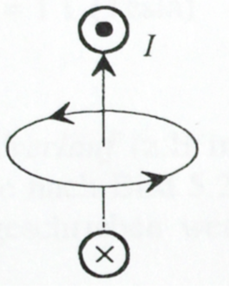
Magnetic circuit
The representation of magnetic field is done by magnetic field lines.
The field line around a current leading leader-loop.

Slide 8
Magnetic circuit
Field lines of the magnetic field around a current flown coil
The path of the magnetic field lines in a magnetic circuit are always closed.

Slide 9
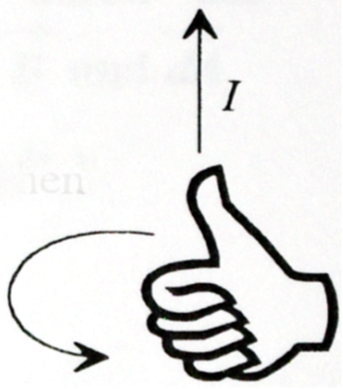
Magnetic circuit
Orientation:
By calcuation of magnatic fields – for example generated by electric current – it is stated that the positive direction of field lines are following right winding direction, where the head of the screwdriver shows the direction of the current.
As a help the right-hand rule can be applied.

Slide 10
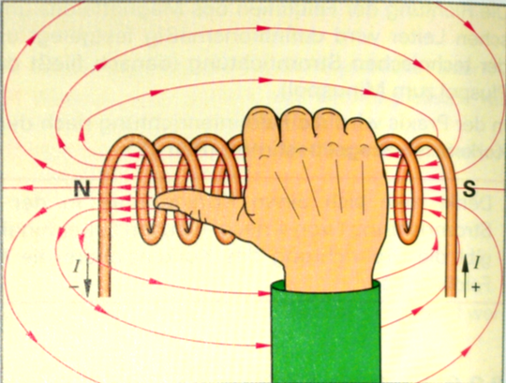
For determiation of the Noth-pole, again the right-hand rule can be used.

Slide 11
Magnetic Flux and Magnetic Flux density
Magnetic Flux
The total amount of the magnetic field lines are called magnetic flux (denoted Φ or Φ_{B}).
More exactly: the magnetic flux through a surface is the surface integral of the normal component of the magnetic field B passing through that surface
The SI unit of magnetic flux is the Weber

Slide 12
Magnetic Flux and Magnetic Flux density
Magnetic Flux-density
The flux density can be defined by a surface element dA, which for the flux line elements dΦ perpendicular oriented, In this way the Flux-density B can be calculated.
The equation of calculation the magnetic Flux-density is:

Slide 13
Magnetic Flux and Magnetic Flux density
Magnetic Flux-density
For a homogenous field e.g within a cilinder-winding the flux-density can be calculated as:

Slide 14
Current leading leader perpendicular to the field-lines of magnetic field:
Magnetische Flux-density
where:
B the magnetic Flux-density in Newton pro Amperemeter [N/Am]
F the force in Newton [ N ]
I the currentin Ampere [ A ]
l the length of the leader [ m ]

Slide 15
Example:
In a current flown electric leader of 0.50 meter flows electric current of 5 Ampers. The acting force is 0.6 Newton.
Determne the magnetic flux-density
Solution:
l = 0.50m
I = 5A and
F = 0.6N
After substitution of the values:

Slide 16
Magnetic flux-density
When a current leading leader is not perpendicular to the magnetic field: Magnetic flux-density equation
Where:
B the magnetic Flux-density in Newton pro Amperemeter [N/Am]
F the force in Newton [ N ]
I the currentin Ampere [ A ]
l the length of the leader [ m ]
α the angle between leader and field.

Slide 17
Magnetic Flux density and magnetic Field
Magnetic field
Where:
B die magnetc Flux-density in Newton per Amperemeter [N/Am]
μ₀ die magnetic field konstant in Voltsekunds per Amperemeters [Vs/Am]
μ_{r} die permeability
H die magnetic field in Ampere / meter [ A/m ]
Tip: μ₀ = 1.2566 · 10⁻⁶ Vs/Am.
The permeability is depending on the material.

Slide 18
Permeability (μ)
In electromagnetism, permeability is the measure of the ability of a material to support the formation of a magnetic field within itself. Hence, it is the degree of magnetization that a material obtains in response to an applied magnetic field. Magnetic permeability is typically represented by µ. The term was coined in September 1885 by Oliver Heaviside. The opposite of magnetic permeability is magnetic reluctance.

Slide 19
Permeability constant (μ₀)
The permeability constant (µ₀), also known as the magnetic constant or the permeability of free space, is a measure of the amount of resistance encountered when forming a magnetic field in a classical vacuum. The magnetic constant has the exact value (µ₀ = 4π × 10⁻⁷ H·m⁻¹ ≈ 1.2566370614…×10⁻⁶ H·m⁻¹ or N·A⁻²).
Permeability is measured in Henries per meter (H/m), or equivalently in Newtons per Ampere squared (N·A⁻²).

Slide 20
Relative permeability (μ_{r})
Relative permeability, denoted by the symbol µ_{r}, is the ratio of the permeability of a specific medium to the permeability of free space µ₀:

Slide 22
Around a current leading leader, the movement of charged particels form a magnetic field.
If the leader, like in a winding laid upon itself, the value of the Ampere turns increases. The sum of the current crossing a surface is called Ampere turns. Θ (Theta), or At
The amperwindung is the driving forca for magnetic field. Same as voltage is the driving force for current.
Unit
The unit of amperwindung Θ (Theta) is Amper (A) or Ampere turns (At).
Equation
Magnetic Apere turns Θ

Slide 23
Magnetic Apere turns Θ

Slide 25


Magnetic field H
The ampere turns within a winding forms magnetic field. The magnetig field lines are expanding to the outside of the winding, and magnetizes the environment.
The magnetic field is the ampere turns per mean field line length, or the winding length.
Unit A/m

Slide 26
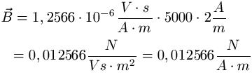
Example
Wir setzen den Werkstoff Eisen (μ_{r} = 5000 ) und die magnetische Feldstärke H = 2A/m ein und berechnen damit die magnetische Flussdichte.

Slide 27


Magnetomotive force MMF
Magnetomotive force (MMF) V_{m}
The magnetomotive force is a lineintegral of the magnetic field H among s path defined by P₁ and P₂ points.
The closed form of the integral around the whole magnetic circuit gives the driving force of the magnetic field, which is the amperwinding.

Slide 28
Magnetomotive force MMF
The magnetomotive force is a quantity appearing in the equation for the magnetic flux in a magnetic circuit, sometimes known as Hopkinson's law. It is the property of certain substances or phenomena that give rise to magnetic fields:
where Φ is the magnetic flux and R is the reluctance of the circuit. It can be seen that the magnetomotive force plays a role in this equation analogous to the voltage V in Ohm's law: V = IR, since it is the cause of magnetic flux in a magnetic circuit:

Slide 29
Magnetomotive force MMF
1:
where N is the number of turns in the coil and I is the electric current through the circuit. Sometimes the unit of gilbert is used to express ℱ
2:
where Φ is the magnetic flux and R is the magnetic reluctance
3:
where H is the magnetizing force (the strength of the magnetizing field) and L is the mean length of a solenoid or the circumference of a toroid

Slide 30

Magnetic Resistance
Such materials in the magnetic circuit which are the magnetism hardly leiting like para- or diamagnetic materials are called magnetic resistances..
Magnetic resistance then descibes the relation between MMF (V_{m}) and magnetic flux (Φ).
The permeability of supraleiters μ_{r} = 0 therefore they are ideal magnetic isolators.

