Slide 1
The conceptual basis for skyhook control
Ag M A
Neptun

Slide 2
Content
MR-Fluid
Overview
Characteristics
Utilisations
Passive and Active suspension
Skyhook control

Slide 3
Overview – MR fluid
The discovery of MR fluids is credited to Jacob Rabinow in 1940’
damper filled with magnetorheological fluid, which is controlled by a magnetic field, usually using an electromagnet.
Continuously controlled by varying the power of the electromagnet
Notes:
US National Bureau of Standards

Slide 4
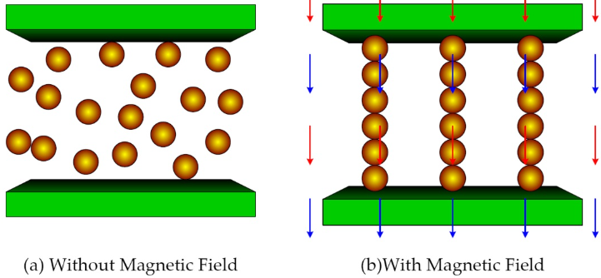
MR-Fluid
A magnetorheological fluid (MR fluid) is a type of smart fluid in a carrier fluid, usually.
Under a magnetic field, the fluid greatly increases its apparent viscosity, to the point of becoming a viscoelastic solid.
Notes:
- a type of oil; with varying percentage of micron- sized (µ) iron particles coated with anti-coagulant material
- the yield stress of the fluid when in its active ("on") state can be controlled very accurately by varying the magnetic field intensity

Slide 5
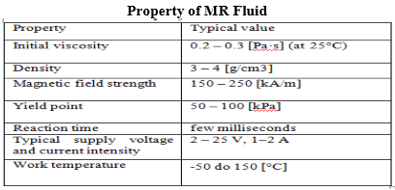
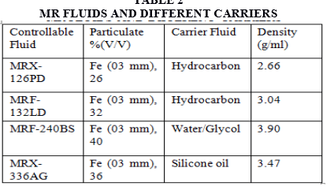
Mr fluid
The MR effect is immediately reversible if the magnetic field is reduced or removed. Response times of 6.5 ms have been recorded.

Slide 6
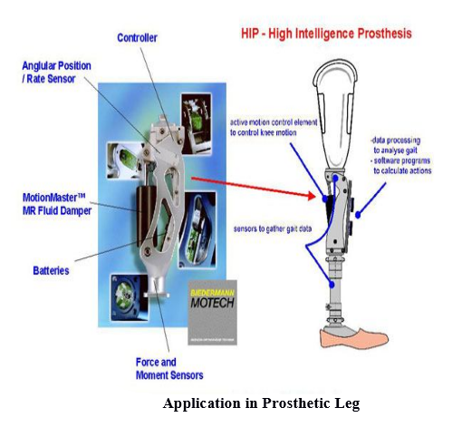
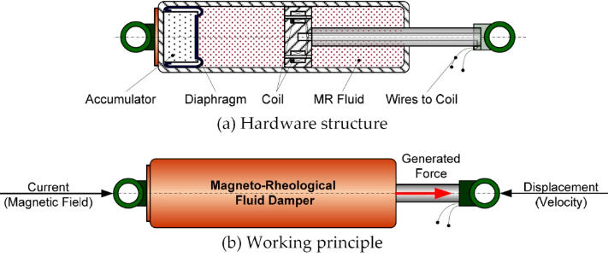
Application of MR-Fluid
dampers,
shock absorbers,
rotary brakes,
clutches,
prosthetic devices,
polishing and grinding devices
semi-active control devices
Notes:
It is capable of generating a force with magnitude sufficient for rapid response in large-scale applications

Slide 7
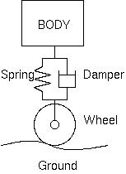
Suspension system
Active suspension is a type of automotive suspension that controls the vertical movement of the wheels relative to the chassis or vehicle body with an onboard system, rather than in passive suspension where the movement is being determined entirely by the road surface,
Skyhook theory is the theory that active suspension systems are targeting.

Slide 8
Active vs Passive suspension
https://www.youtube.com/watch?v=ket6bDuzoVQ

Slide 9
Skyhook damper
While the vehicle is in motion, the sensors supply all the information including braking and road speed signals which the ECU needs in order to produce optimum damping effort.
The ECU then controls individual damping action to each wheel separately in accordance with parameters stored in the software.
https://www.youtube.com/watch?v=W5zblLY4R3Y

Slide 10
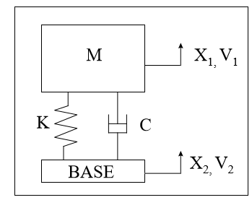
Skyhook Control
- Passive Damping :
We can derive the transmissibility of the passive seat suspension as:

Slide 11
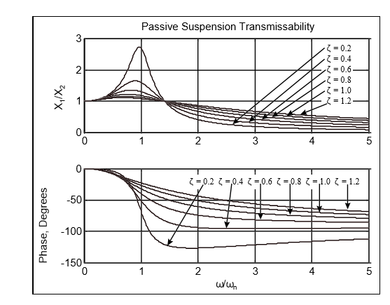
Skyhook Control - Passive suspension
At low passive damping ratios, the resonant transmissibility (around ω = ω n) is relatively large, while the transmissibility at frequencies above the resonant peak is quite low. The opposite is true for relatively high damping ratios.
Passive suspension Transmissibility

Slide 12
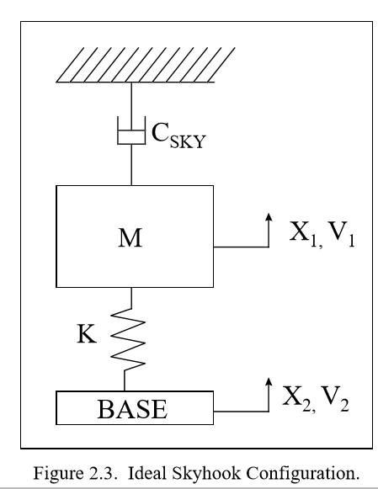
Ideal Skyhook Control
Notice : that this is a purely fictional configuration, since for this to actually happen, the damper must be attached to a reference in the sky that remains fixed in the vertical direction, but is able to translate in the horizontal direction.

Slide 13
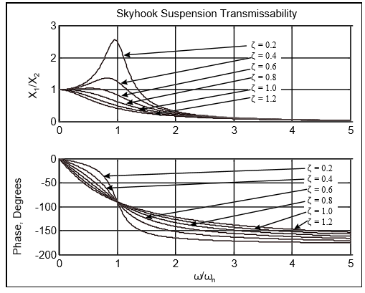
Ideal Skyhook Control
As in the passive case, as the skyhook damping ratio increases, the resonant transmissibility decreases. Increasing the skyhook damping ratio, however, does not increase the transmissibility above the resonant frequency. For sufficiently large skyhook damping ratios (previous ex : ζ >0.707), we can isolate even at the resonance frequency.

Slide 14
Skyhook Control
Passive suspension Transmissibility
Ideal skyhook suspension Transmissibility

Slide 15
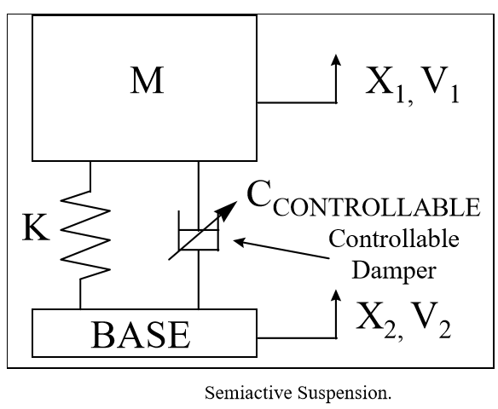
Semi-active dampers
One method of generating the skyhook damping force is to remove the passive suspension, both the damper and the spring, and replace it with an active force generator.

Slide 16
Conclusion
MR dampers offer an attractive solution to energy absorption in mechanical systems and structures and can be considered as “fail-safe” devices

