Slide 1

Traction control & Electronic throttle control system
Msc Mechatronic Engineering
Dynamics of vehicule
Name: Arfaoui hatem
Neptun: a8ud5i

Slide 2
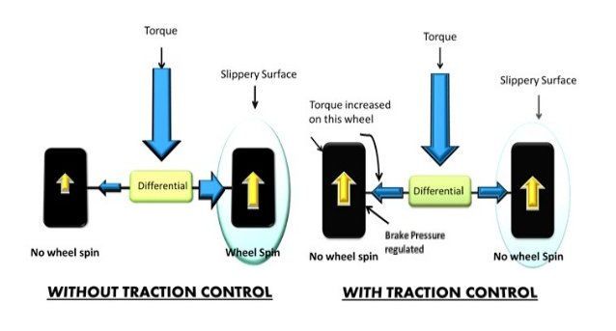
INTRODUCTION
Torque is usually split 50/50 left to right, if a wheel slips most of the torque go to that wheel because of open differential that allows torque to take the path of least resistance.
TCS controls the engine output and applies brake pressure to the slipping wheel until that wheel begins pressure creates resistance, so torque is reduced to the slippery wheel and increased to the wheel on the opposite side.
traction control helps prevent your wheels from spinning on low-friction surfaces.

Slide 3
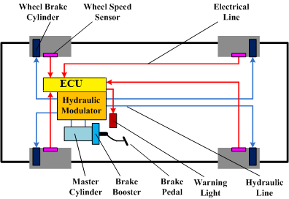
Components of TCS
In most modern vehicles the traction control feature uses the same components as ABS, including:
wheel-speed sensors
hydraulic modulator
ECU (electronic control unit)

Slide 4
How does TCS work?
Traction control uses individual wheel-speed sensors to measure differences in the rotational speed of each wheel.
These sensors are located on each wheel. When the ECU senses that one wheel is spinning faster than the others (an indicator that the wheel is losing traction), it sends a message to the hydraulic brake-modulator (attached to the ECU) and automatically reduces the speed of that wheel which lessens the slip.

Slide 5
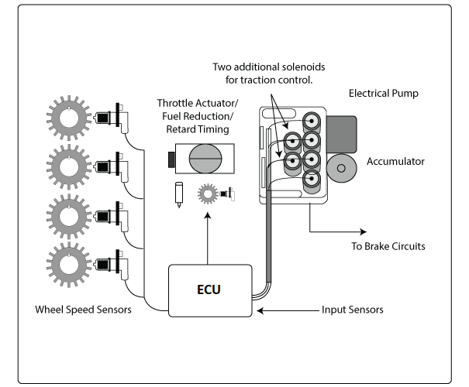
How does TCS work?
The ABS and TCS systems share the same wheel speed sensors. The TCS system requires two additional solenoids in the hydraulic modulator assembly. These solenoids are used to open and close the passages to brake circuit to prevent lock up during hard or severe braking.
An electric pump and accumulator are used to apply the wheel brake on the wheel that has lost its traction. If one wheel were to lose traction, the pressurized fluid is used to apply the brakes on the wheel that is spinning.

Slide 6
How does TCS work?
The TCS system use also an actuator to reduce power at speeds above 30 mph.
This is accomplished by closing the throttle on vehicle's with electronic throttle controls, retarding timing, or decreasing fuel injector pulse width. This not only helps the vehicle regain traction but also helps to prevent damage and overheating of the brake system..

Slide 7
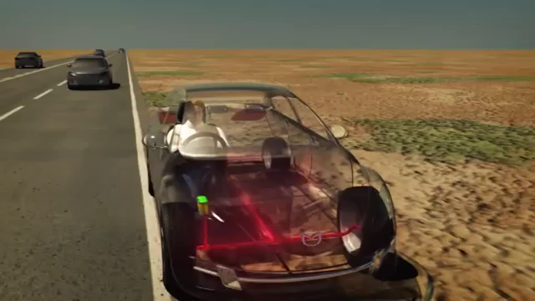
Mazda TCS

Slide 8
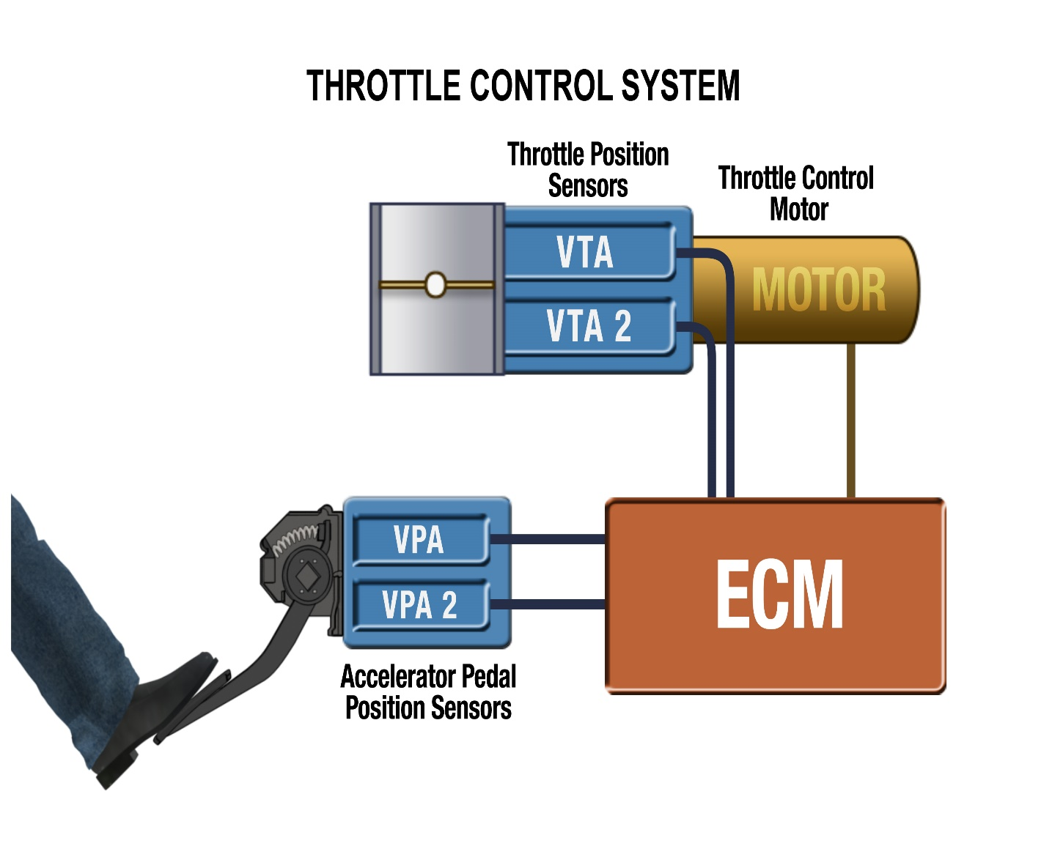
Electronic throttle control
In ETC systems, a vehicle's ECU uses information from the throttle position sensor, accelerator pedal position sensor, vehicle speed sensor and a variety of other sensors to determine how to adjust throttle position
ETC system consists of these major components:
Accelerator position sensors
Throttle body
Throttle position sensors
Throttle control motor
Engine control module

Slide 9

Electronic throttle control

Slide 10


